Slide 1
Elevation Work Group Updates TUgis 2018 Room 3216 12:30p-1:30p Call-in information (301)883-6600; Code: 418191#
http://msgic.org/elevation/
Roger Barlow, rbarlow@usgs.gov
Erin Silva, elsilva@salisbury.edu

Slide 2
Agenda
Current and Potential Acquisitions
Maryland and District of Columbia
Regional: 3DEP
Regional: NOAA Topo/Bathy Updates
Mobile Ground Based LiDAR:
Al Wainger, Michael Baker Intl
Mike Sheffer, SHA; Joe White, SHA
3D Nation Survey
CoNED
MD iMAP Products and Services
Work Group Initiatives

Slide 3
Maryland and DC Topographic LiDAR
2018 QL2 Montgomery & Prince George’s
2018 QL1 Ellicott City / Howard County
2019 QL2 Lower Eastern Shore: Somerset, Wicomico, Worcester
2018 QL2 District of Columbia
Others?

Slide 4
3DEP Topographic Lidar
New Jersey (5 counties): to be acquired 2018/19. 3DEP and NJ funding
Pennsylvania (16 counties): acquired 2017/18. 3DEP, USGS, NRCS partnership
Central Virginia (10 counties)and Eastern Virginia (12 counties). 3DEP, USGS, NRCS, VGIN partnership
*All QL2 data
New dynamic elevation service using 3DEP data
The new elevation platform creates multi-resolution visualizations on-the-fly, allowing users to explore a variety of representations including: hillshade; aspect; slope; and tinted hillshade maps, as well as automated contours and more. In addition, Open Geospatial Consortium (OGC) Web Map Service (WMS) and Web Coverage Service (WCS) interfaces are enabled to support interoperability across systems. More details and access:

Slide 5
Topo/Bathy
NOAA: NJ, DE, MD, VA coastal strips flown in summer 2017 by USACE as part of a coastal US 4-year cycle available from Digital Coast, classified points.
USACE Joint Airborne Lidar Bathymetry Technical Center of Expertise (JALBTCX):
Topo/bathy lidar- mission to acquire sandy coastline/barrier islands .5- kilometer inland, and offshore to 1 kilometer
4-year rotating schedule, summer 2017 acquired GA. to Montauk, NY
Uses Coastal Zone Mapping Imaging Lidar (CZMIL)
NJ is published on Digital Coast, looking for MD-DE later this month

Slide 6
Mobile Ground-based LiDAR Acquisitions
Al Wainger, Michael Baker
Mike Sheffer and Joe White, SHA

Slide 7
3D Nation Survey
Follow-on to 2011 NEEA Study
MD Participants: DoIT, DNR, MDE, ESRGC, others?
Other participants: Feds, non-profit, academic sector
What’s next? – Dewberry survey tabulation & initial analysis, workshop with state participants, final analysis- report and recommendation.

Slide 8
Coastal National Elevation Dataset
Topobathymetric Elevation Model of Chesapeake Bay
Hurricane Sandy had significant impacts throughout the Chesapeake Bay, altering the topography and ecosystems of this populous coastal region. In response to the storm, the U.S. Geological Survey (USGS) Coastal and Marine Geology Program in collaboration with USGS National Geospatial Program, and National Oceanic and Atmospheric Administration developed three-dimensional (3D) topobathymetric elevation models for the Chesapeake Bay area. Chesapeake Bay, the largest estuary in the contiguous United States, lies inland from the Atlantic Ocean, and is surrounded by Maryland and Virginia. Numerous major rivers and streams, such as the Susquehanna and Potomac Rivers, drain through the Washington, D.C. and Baltimore megalopolis into the Chesapeake Bay. Additional information about topobathymetric elevation models is available online at https://lta.cr.usgs.gov/coned_tbdem. To view or download the Chesapeake Bay topobathymetric elevation model, visit the CoNED Project Viewer, USGS EarthExplorer or The National Map Viewer.

Slide 9
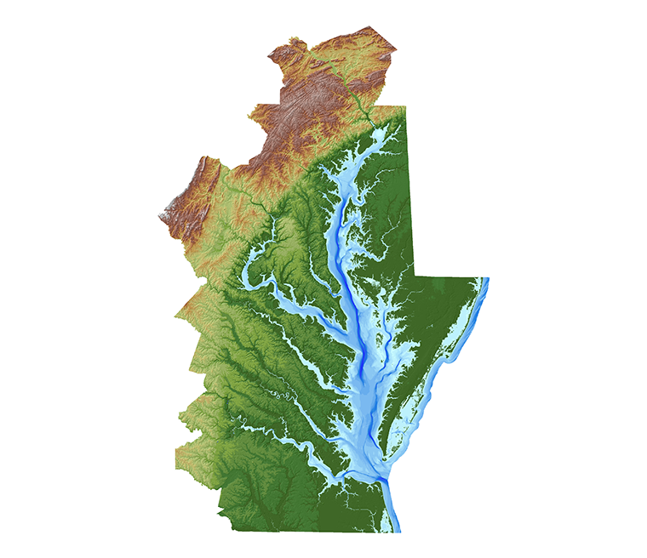
Coastal National Elevation Dataset

Slide 10
MD iMAP: Products and Services
2017 QL1 Anne Arundel and Calvert collections
Topography Viewer
LiDAR Services Migration
Download by:
Custom user-defined extent
Pre-defined extent
DEM
Metadata, FAQs, Training
Upcoming
Historic Lidar
Montgomery and Prince George’s QL1 collections
Case Studies on benefits of QL1 vs QL2

Slide 11
Work Group Initiatives
Discussion Topics
Goals and Objectives
Return on Investment Study
Development of Standards: Collection and Metadata
Maryland focused use cases
Education Opportunities: bathymetry; LiDAR technology: sensors, vendors, etc; software and products, point classification
Potential products and services: watershed DEMs, contours, bathymetric data (hosting, training)
Others?
Questionnaire
Potential Website Updates
Subscribe to elevation email list, blogs, Twitter #ElevationWG, resource links
Upcoming Meeting Schedule

Slide 12
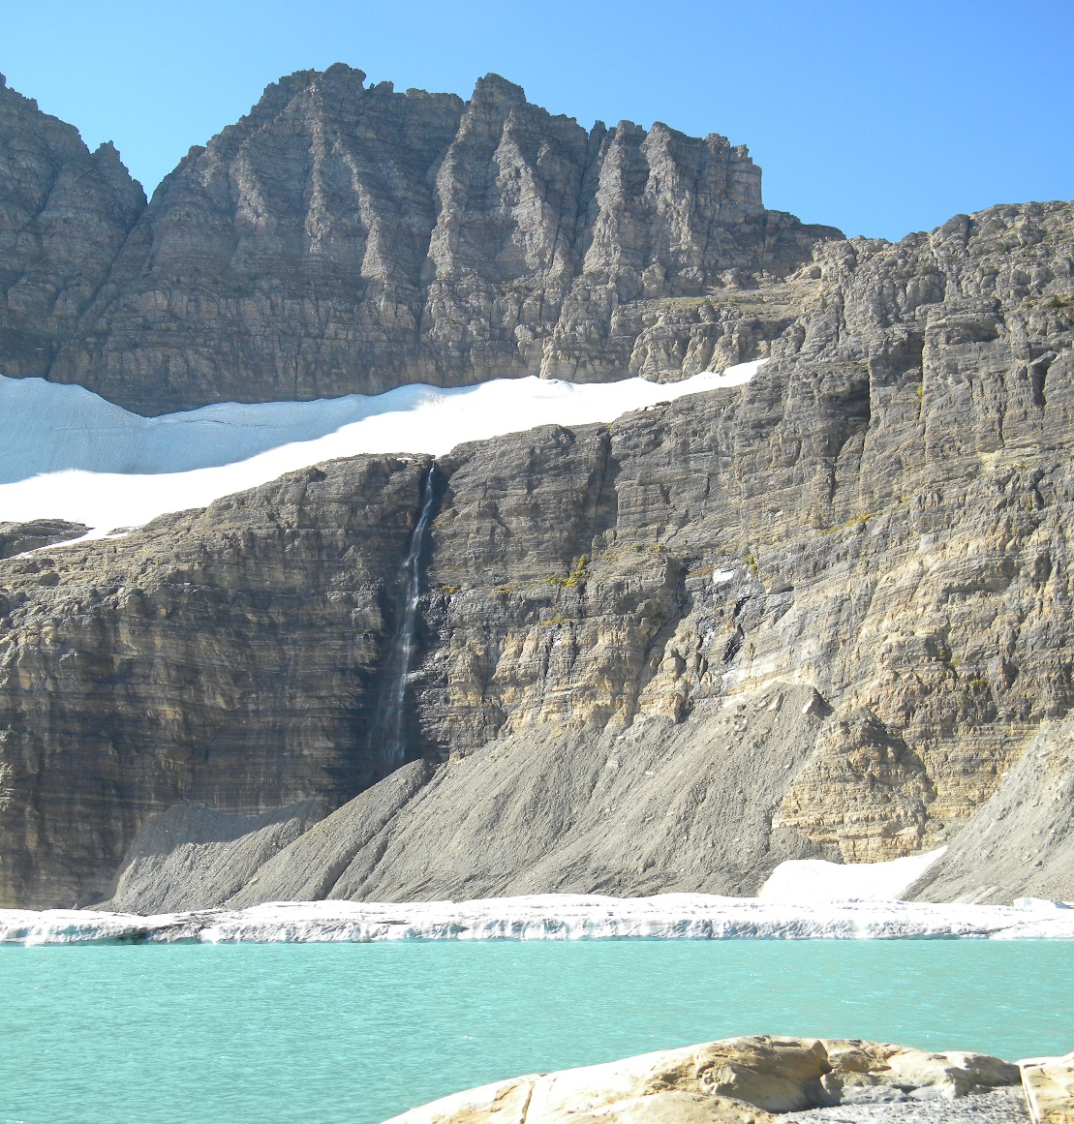
Feedback/Discussion
What elevation data or capabilities do you need to do your job?

