Slide 1
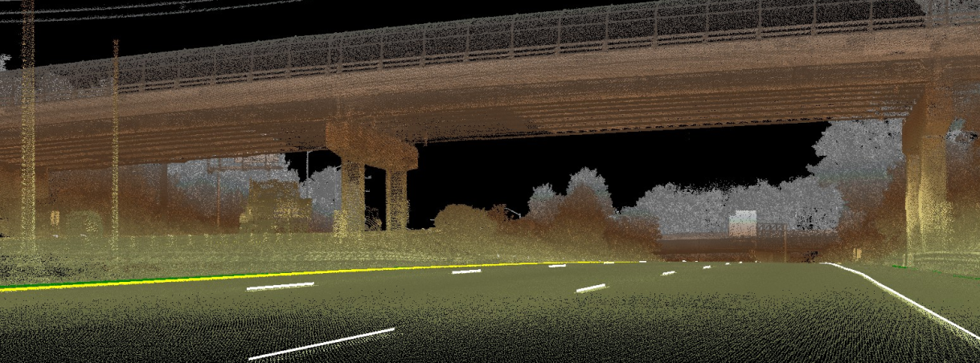
MD 404 Mobile LIDAR Pilot MDOT - SHA
2018

Slide 2
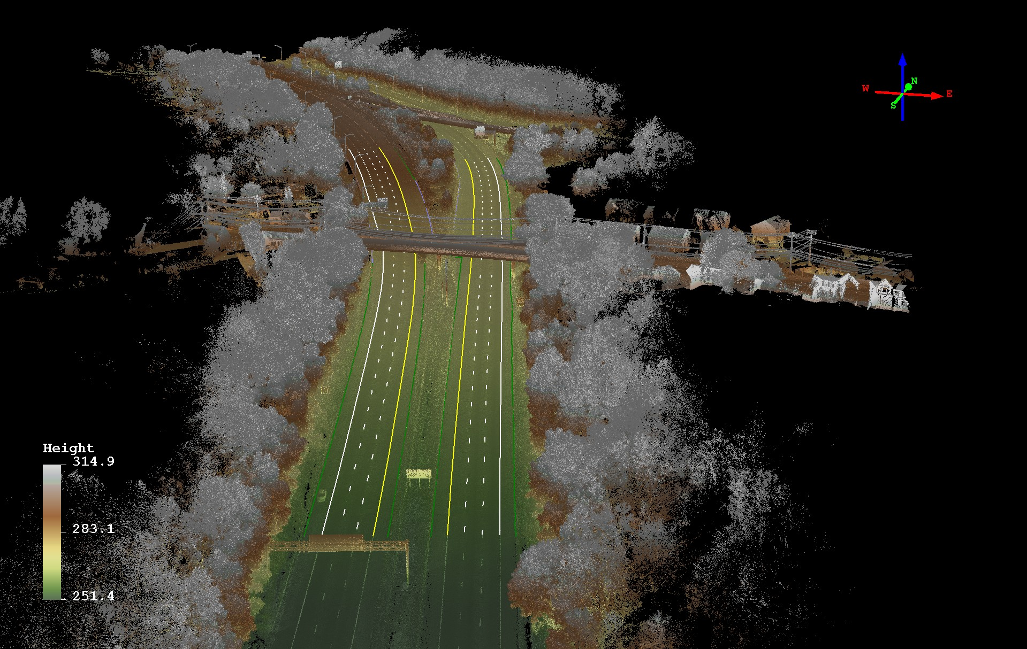
Mobile LIDAR System (MLS)
Mobile LiDAR (Light Detection and Ranging): Imaging system that collect geospatial data by measuring the distance to a target by illuminating that target with a laser light. Mobile systems collect up to 1.4 million 3D points of data at highway speed at a range of approximately 100 meters. Images from high definition cameras (resolution up to 3296 x 2472 pixels) that can capture a selectable rate of 100 to 500 frames per mile.

Slide 3
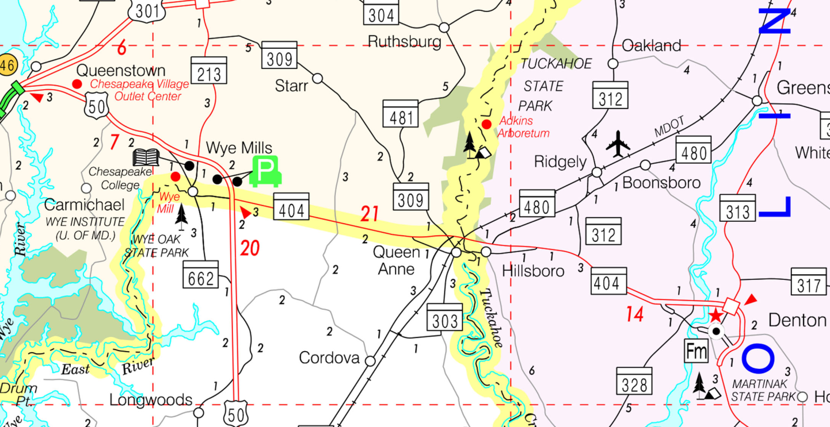
MD 404 widening project
Project area of Maryland State Highway Route 404, from the interchange with U.S. Highway 50 (near Wye Mills) and terminating at the Highway 404/Business 404 interchange west of Denton (approximately 11.5 miles).

Slide 4
Deliverables
Mobile LiDAR Mission Plan
Photographs captured in JPG format
Calibrated LIDAR 3D point cloud in LAS and POD formats (can be used in Microstation)
http:// link to Michael Baker’s 3D Streaming Orbit environment for visualization and measurement
ESRI Geodatabase in accordance with approved Data Dictionary
WebViewer training session
Recorded session on LiDAR point cloud integration with MicroStation

Slide 5
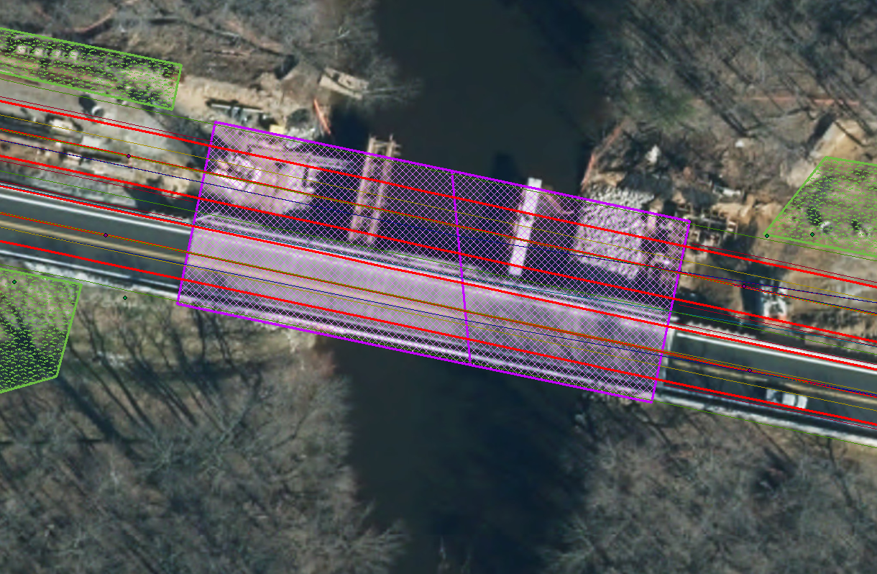
MD 404 - 3D Point Cloud Data Extraction
Barriers
Bridge Decks
Mowable Areas
Curve and Grade
Cross Slope
Lane Information
Shoulder Information
Median Information

Slide 6
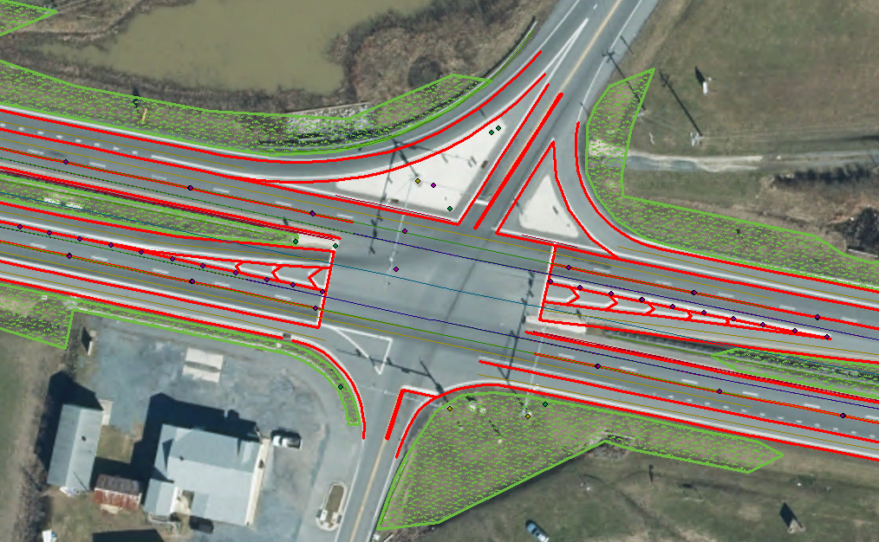
MD 404 - 3D Point Cloud Data Extraction
Sign Panels
Sign Installs (posts, etc.)
Lightpoles
Lighting Panels
Lighting Signs
Raised Pavement Markings
Rumble Strips
Painted Lines

Slide 14
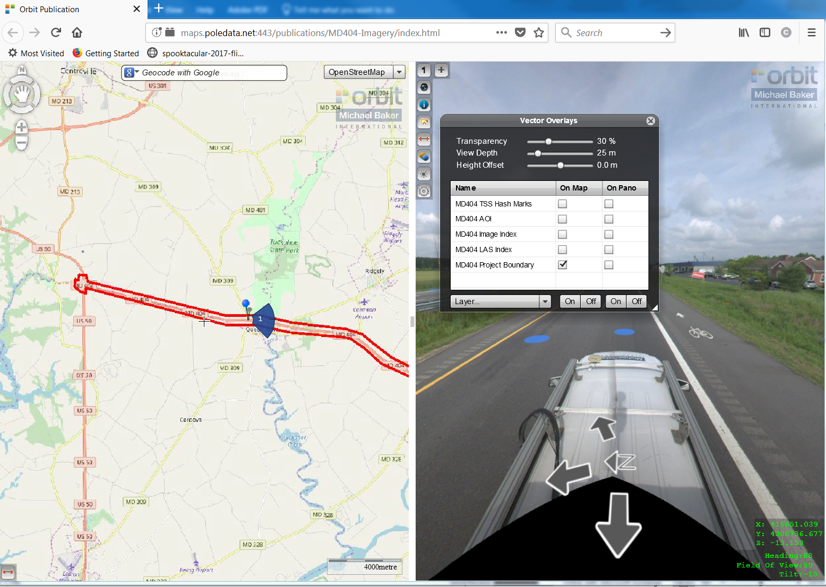

Slide 15
Orbit Web Viewer
http://maps.poledata.net:443/publications/MD404-Imagery/index.html

