Slide 1
Mobile LiDAR
and
the 2016 Flood in
Old Ellicott City

Slide 2
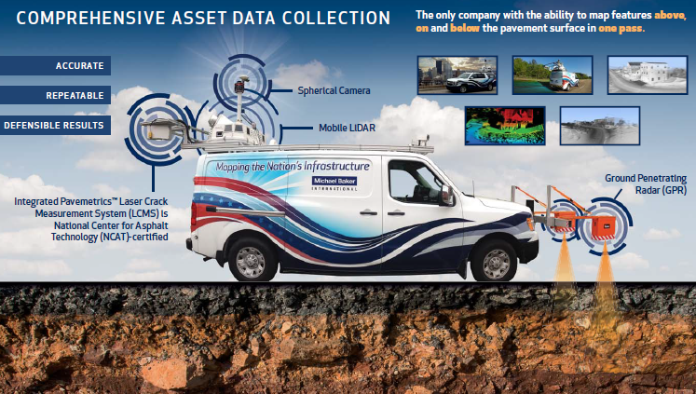
Mobile LiDAR
Notes:
Landing page when you login
Staff get emails when there are new work orders in their area of expertise
My Orders shows all your assigned orders.
Click an order number or the Edit button to get information about the task.
Click the hand to unclaim the task.
Click the checkmark to complete the task. Depending on its status in the workflow, this can send the task to QA or mark it as complete
Current Orders shows all active orders. Ones you can claim have a hand icon.
Staff can claim any task they have permission to work on (different users can have permissions to complete tasks, perform QA, or have access to different types of projects based on their expertise)
Managers can assign a task to a user

Slide 3
Mobile LiDAR Instrument
LiDAR Sensor
IMU
GPS
Camera
Mobile LiDAR

Slide 4
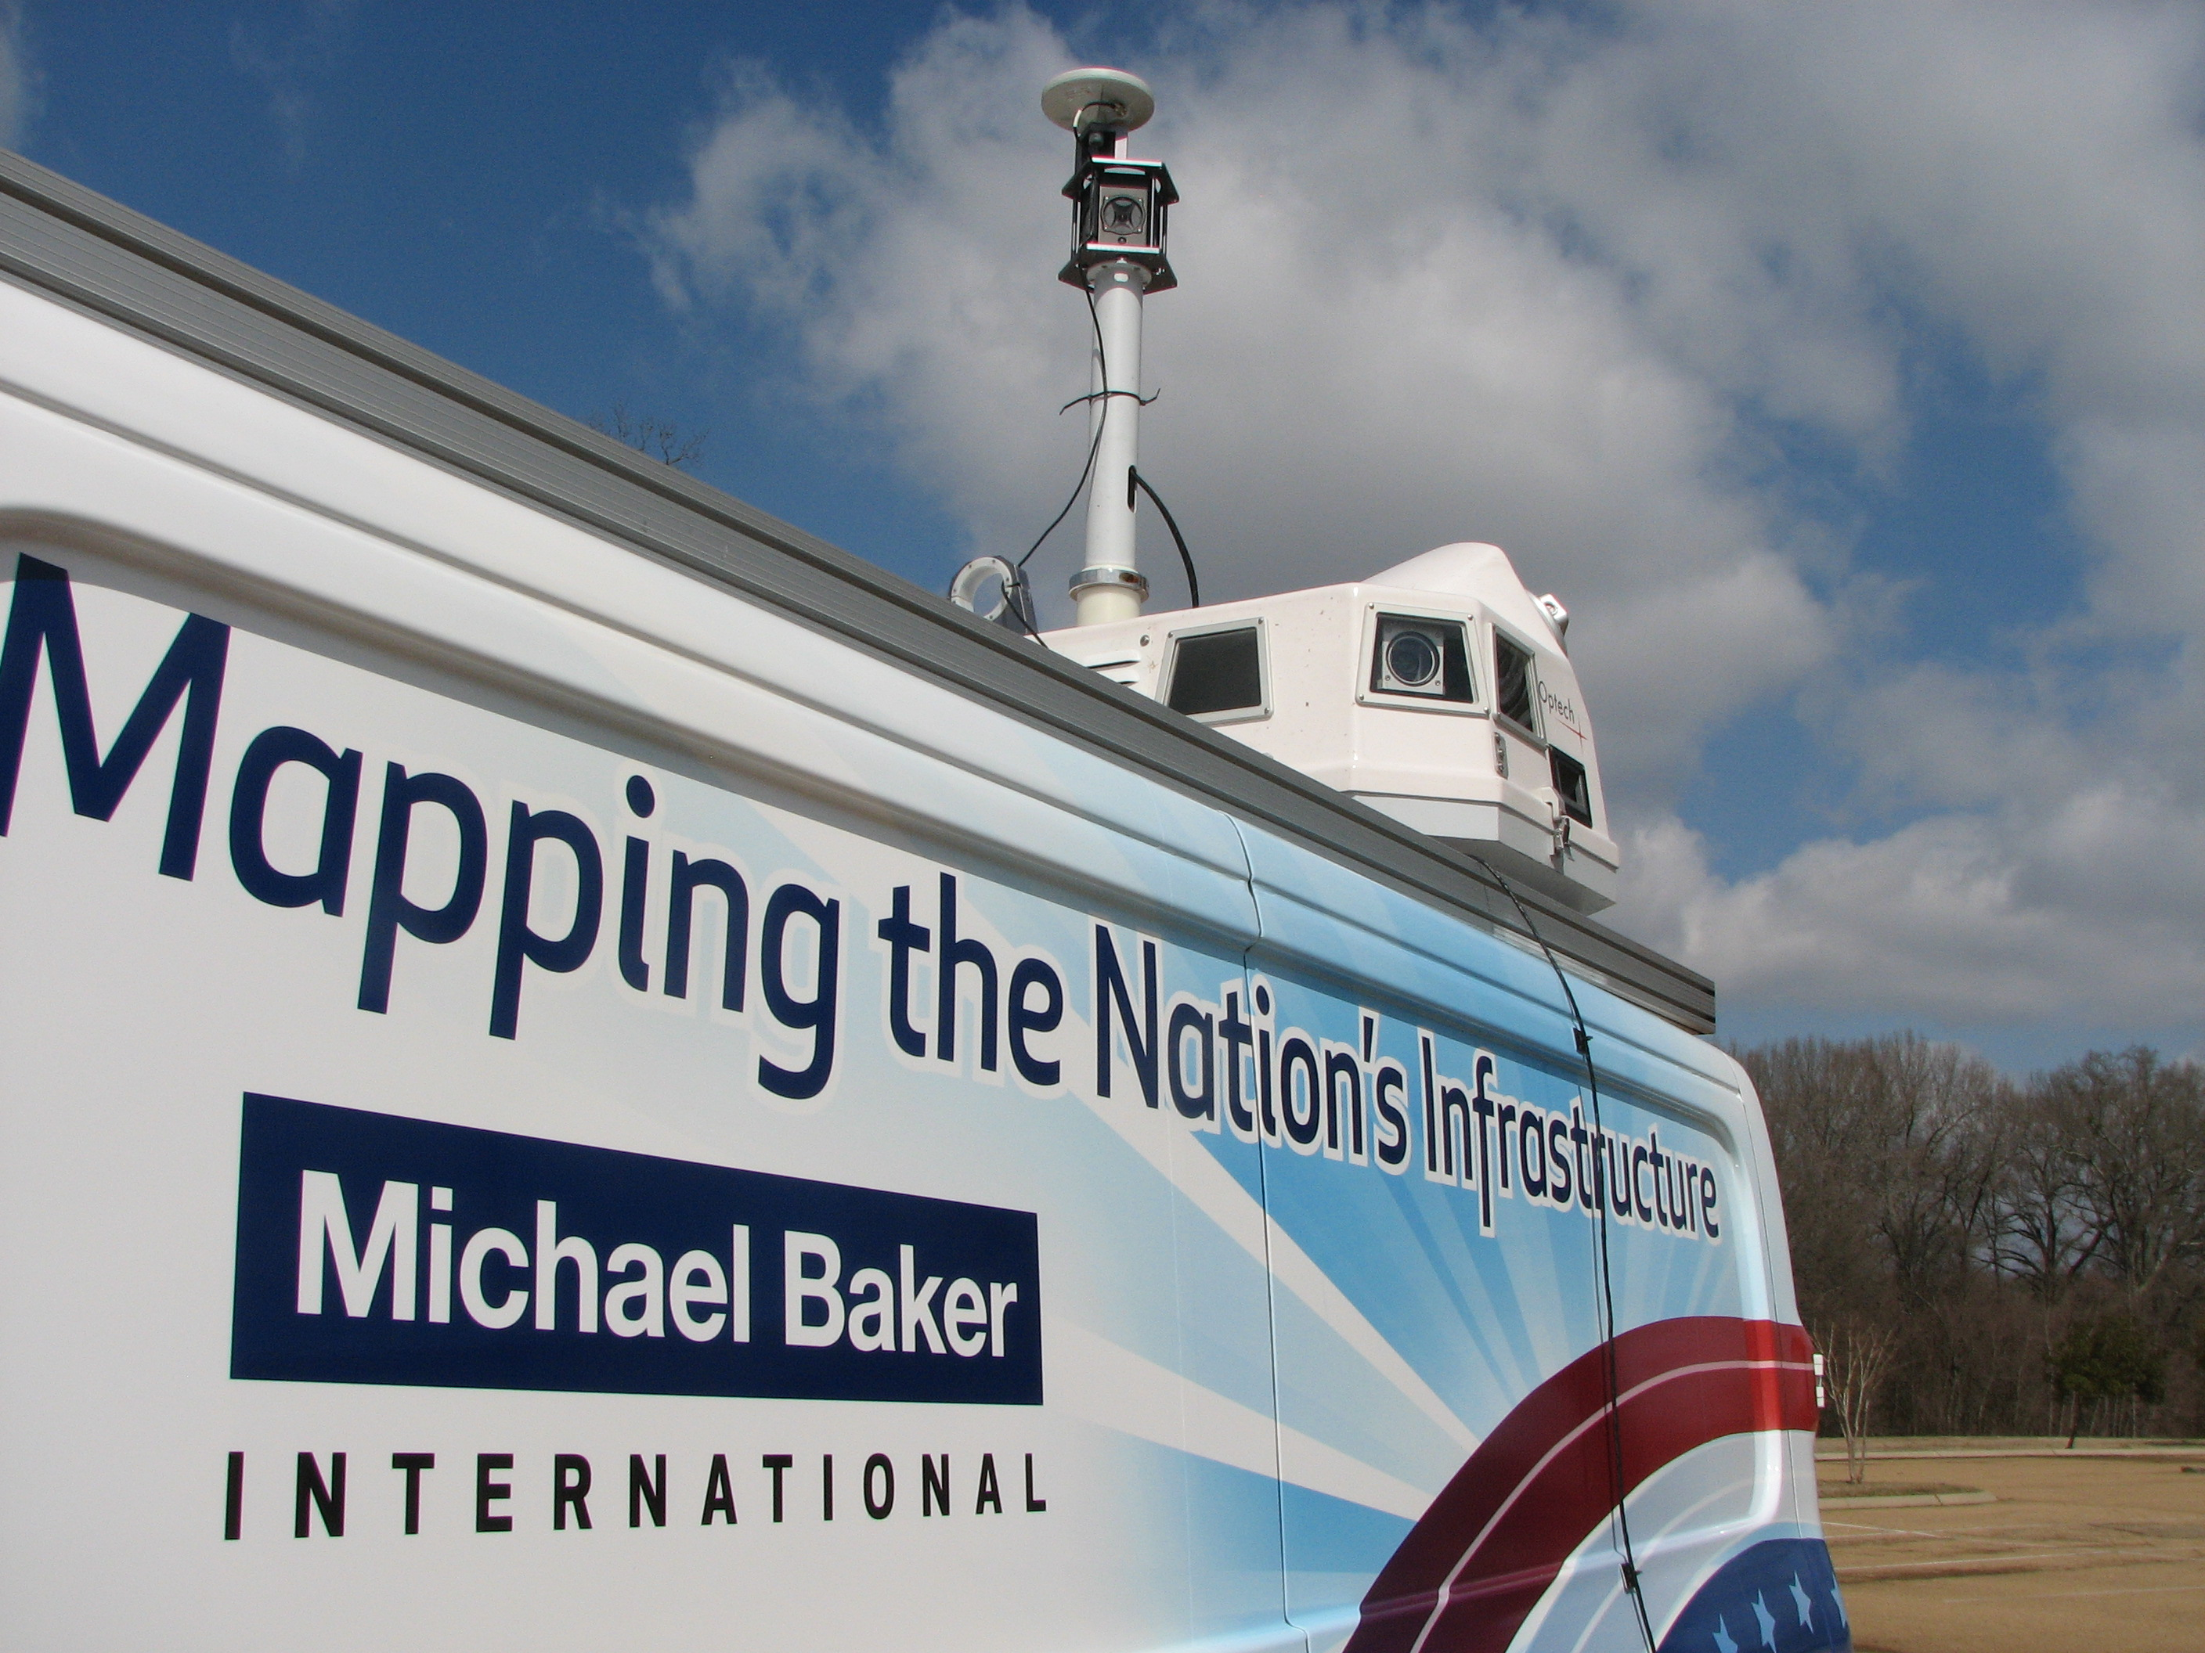
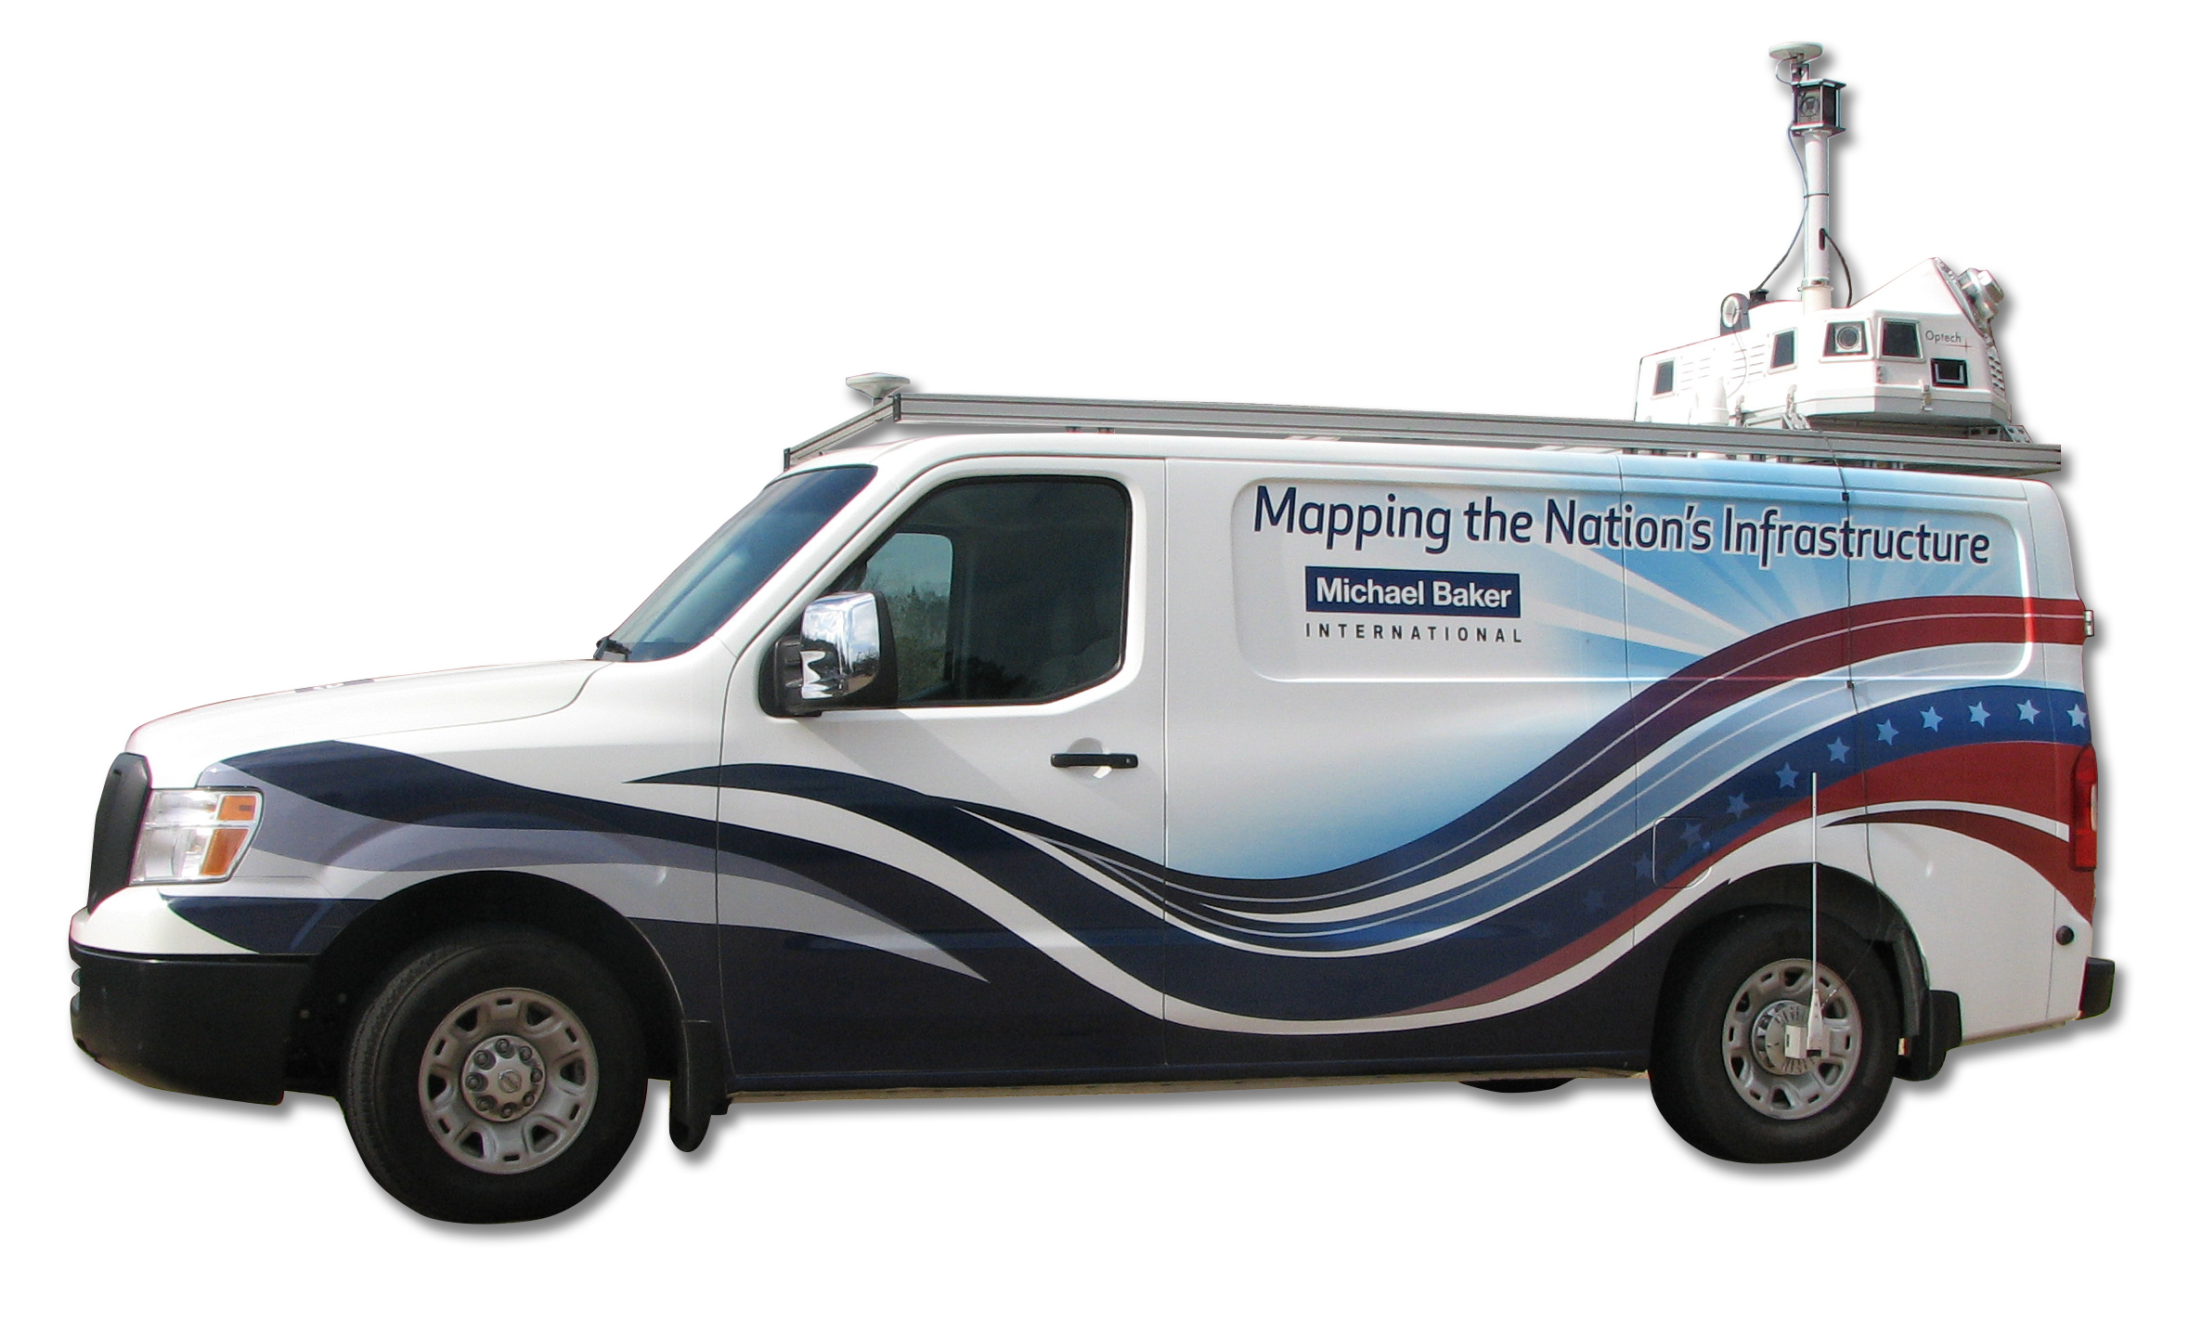
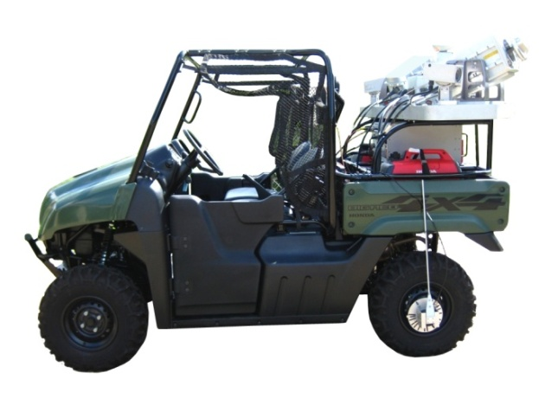
Mobile LiDAR Details
Specifications
Accuracy: < 0.1
Precision: < 5mm
Range: 200m(corridor varies)
Field of View: 360 degrees
Laser Rotates: 9-15,000 RPM
Measurement Rate: 150,300 or 600 kHz
Returns per Shot: 4 (1st,2nd,3rd,Last)
Simultaneous LIDAR & imagery capture
Digital Cameras: 4x-5MP+ Spherical
Image Capture: Defined intervals (example: 50ft)
Our Mobile LiDAR:
…proven collection via SUV, ATV, Hi-rail, and Boat.

Slide 5
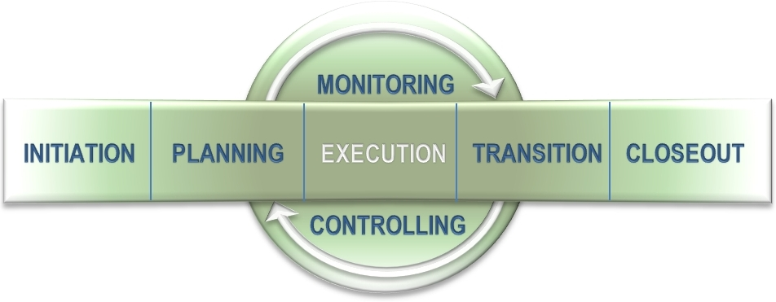
Mobile LiDAR Benefits
Increased Safety
No Interruptions to Operations
Shortened Delivery Cycle
Cost-Savings
Re-usable Engineering-grade Data
Notes:
Users can only edit and delete their own notes
Identify files that are needed for internal communication and which can go to the client

Slide 6
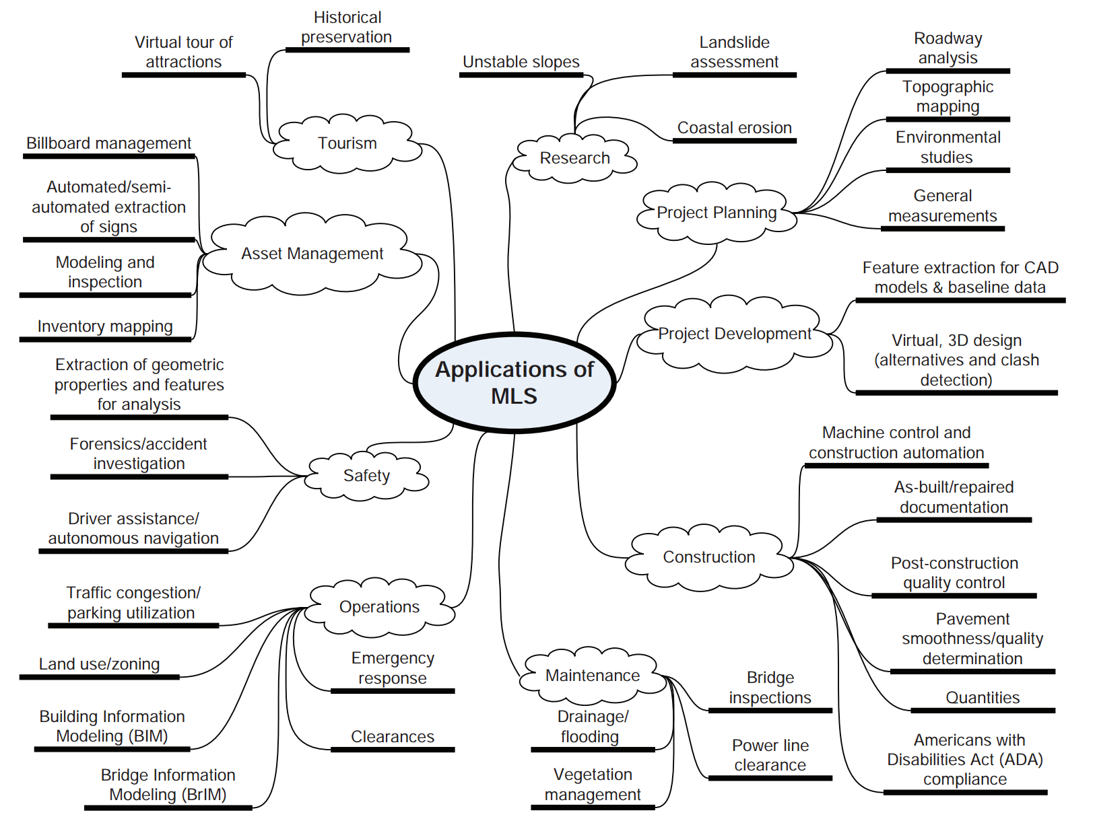
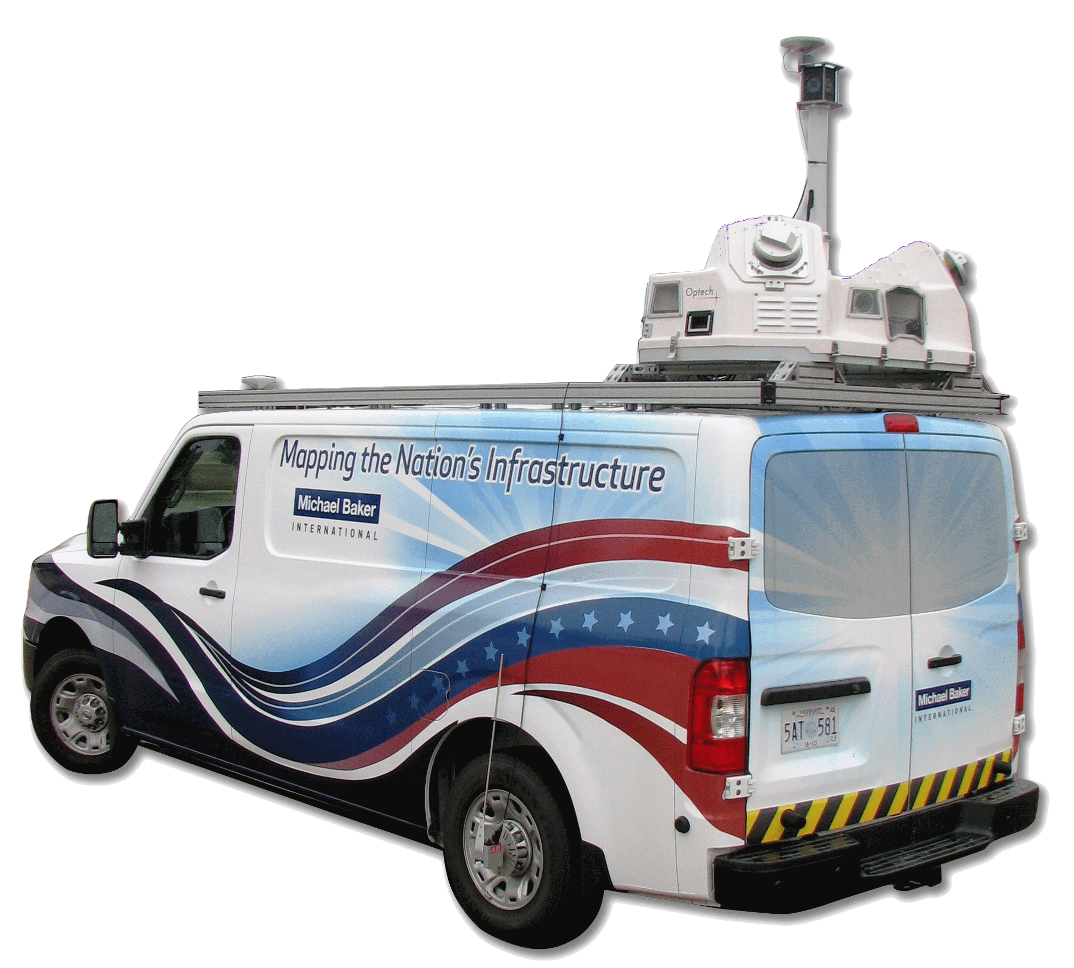
Mobile LiDAR’s many uses

Slide 7
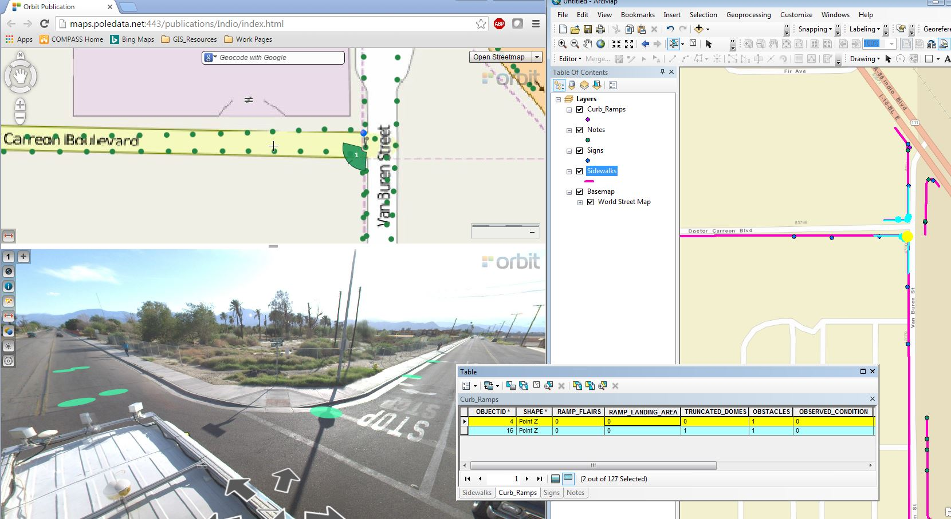
Video log with 360 degree imagery

Slide 8
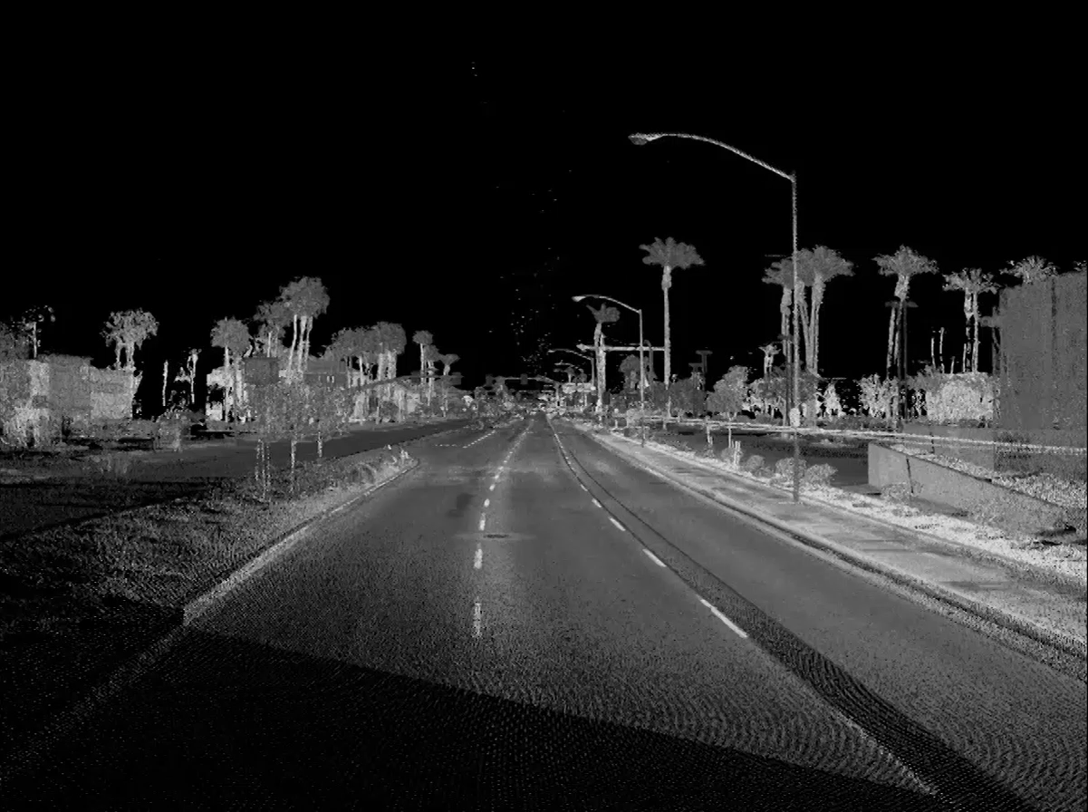
Drive thru 3-D model

