Slide 1
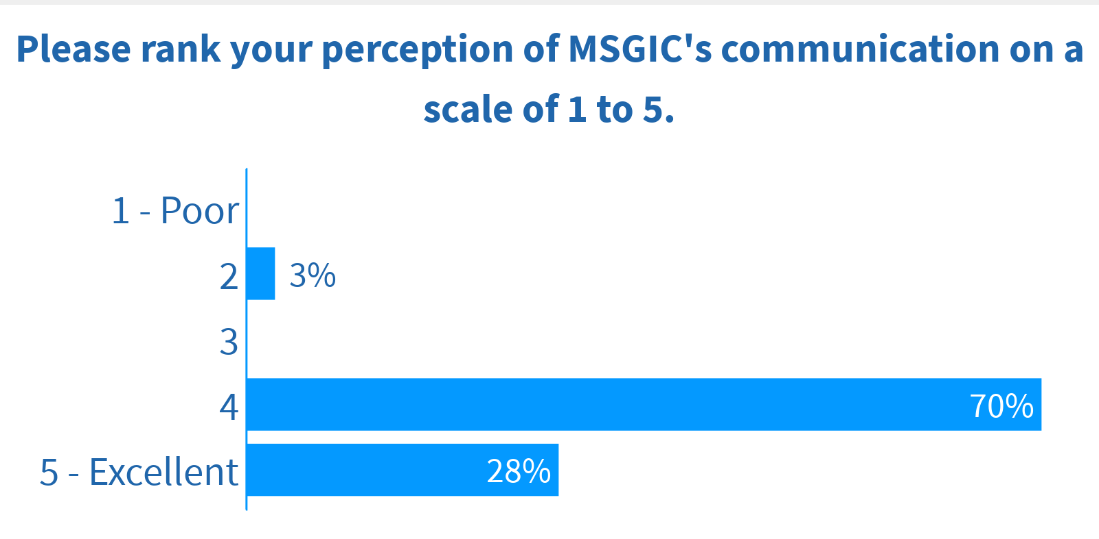
2018 Strategic Goal: Communication
Response | # of People
2 | 1
4 | 28
5 | 11
Total | 40

Slide 2
What do you like about communication within MSGIC or what could be improved?
Response | Screen name
Don't know if there is a way to do this already but more direct communication about what is going on with each of the working groups and opportunities to get involved may be a big help. | Ethan Homesley
Emails occasionally get blocked by my spam filter. It would be great if we received a calendar invite (or a .ics download file) with the login info for meetings via email. | guest560
Transparent in that it reaches all members. Always on topic and informative. | brett dobelstein
Might be nice to send out summary of new job board additions to the mailing list | Graham T
Executive Committee meeting notes are up to date and available | Jen C-M
Information is readily available about different events and where to connect on the calendar on MSGIC's website. The email notifications about events are very helpful. Also love the job board. | Ethan Homesley
I like that communications are sent early | guest647
Emails are good about events | John OBrien
Website redesign needed. Focus on providing information on one place | Patrick Callahan
In general MSGIC communications are clear and spaced out well. Never get the feeling that I am being overwhelmed with emails, tweets, etc as with other orgs I belong to. | mjl
I like email because I can search for them by text. For social, I do use linked in but nor twitter or facebook. | David McSpaden
Upcoming meetings notifications | TJ Bradley

Slide 3
What do you like about communication within MSGIC or what could be improved? (cont’d)
Response | Screen name
We can improve communication to/onboarding of new members. | Shawn
I like email reminders of meetings and the website is informative | Shawn Wampler
I enjoy hearing about statewide initiatives at the quarterly meetings, as well as the training opportunists through the year. | guest097
It's great to get updates on all events but it would be great if we can get weekly updates on upcoming events or activities. | Teddy Hailegeberel
sometimes invites aren't received. Perhaps if there was an automated system that we subscribe to, we'd get all the things we are interested in. | J.B. Churchill
Email seems to work best for me. | guest032
When I changed jobs it was not easy to change my email. I am still not getting the updates. In the past the email were informative. | DMB
Notifications about upcoming meetings. | Anastassiya Suprunova
It was not as regular as it could be. The msgic.org domain will help with messages getting stuck in spam since we are no longer gmail.com. | Julie Spangler
My caucus has provided good email updates of monthly activities! | Graham T
Email notifications were getting blocked by my spam filter | Niki Miller

Slide 4
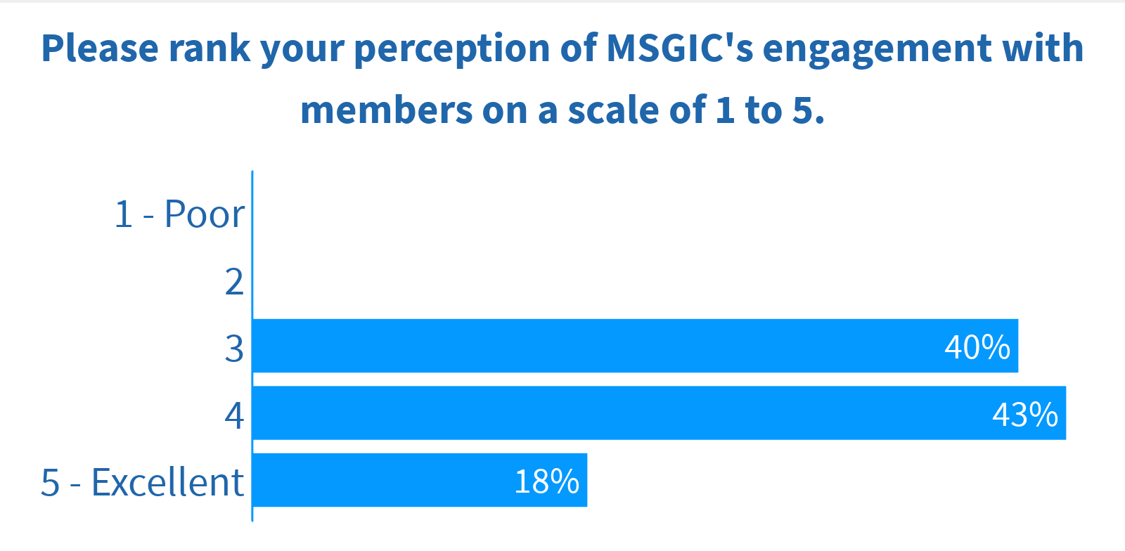
2019 Strategic Goal: Engagement
Response | # of People
3 | 16
4 | 17
5 | 7
Total | 40

Slide 5
What do you like or dislike about MSGIC’s engagement with members?
Response | Screen name
Need more people to not be just a member of MSGIC, but to be active and participate with the initiatives of MSGIC. | Patrick Callahan
Yes, I really like the Lunch and Learns idea and any free training that we can get. | TMW
I think this year's lunch training sessions were great. In general, though, I wonder if MSGIC isn't somewhat, insular, maybe is the word? Seems like the same people always doing the same things. Is our membership growing or shrinking? What does attendance over time look like for quarterly meetings and TUGIS? | mjl
I liked the "Lunch & Learn" events. | guest560
The regular quarterly meetings are a great way to stay up to date with what is going on in the state as far GIS is concerned. | Ethan Homesley
Always trying to keep up with the ever evolving world of GIS. Keeping it fresh. | Kelly L Henry
Always seeking input from members. Providing opportunities for members to get involved and help direct the organization. | brett dobelstein
MSGIC shows concern for its members and makes arrangements to accommodate whatever the issue | guest647
Echoing the 'Lunch and Learn' activities! They are great, and low commitment | Logan Hall
Keep the lunch & learns! | Adam Phipps-Dickerson
Emerging professionals are able to engage directly through events | Jen C-M

Slide 6
What do you like or dislike about MSGIC’s engagement with members? (cont’d)
Response | Screen name
Nothing to dislike really other the some of the presentations/updates being painfully long. | guest097
Welcoming community, have always liked that anyone can attend executive committee meetings. I rely on the community for help on projects from time to time. | Shawn Wampler
Would like to see more opportunities for members to get involved. Meeting notes has some information, but having a centralized list of things that are needed would help | Shawn
Like the way it is. | Bo Yuan
lunch and learns are a great concept. | J.B. Churchill
There are a number of diverse opportunities to engage but sometimes it felt like we had to lobby folks to participate. | Julie Spangler
More polling on how $ should be spent | Logan Hall
Infrequent engagement but like the updates on events. | Teddy Hailegeberel
Like that anyone can join Executive meetings and have their input heard | Graham T

Slide 7
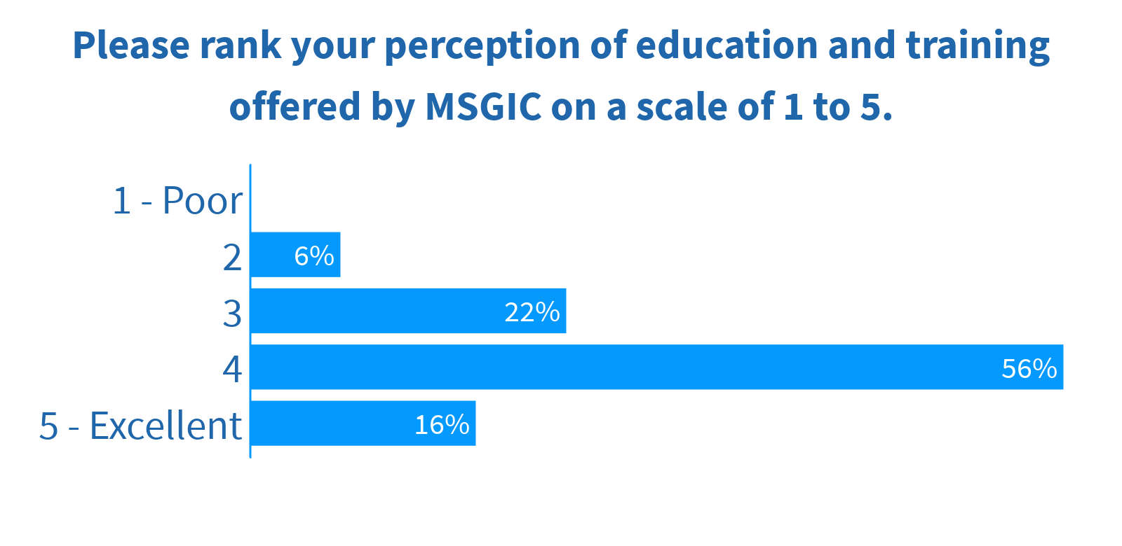
2020 Strategic Goal: Education & Training
Response | # of People
2 | 2
3 | 7
4 | 18
5 | 5
Total | 32

Slide 8
What do you like or dislike about education or training offered by MSGIC?
Response | Screen name
GIS project management, how to facilitate change within an org, we still need to communicate the mission even though GIS permeates many of our govs | Julie Spangler
Would like to see a regular schedule of events. May be interesting to have a cohort type system which moves groups through a progression. | brett dobelstein
Would like to see more notification of the training offered so as not to miss out on any opportunity | TMW
Tiered training is great. Need more member engagement to narrow down what is beneficial to the whole | Logan Hall
'+1 advanced training. I'd personally like to see some programming content. | Adam Phipps-Dickerson
The soft skills training was awesome. Hosting more virtual, hands-on training would be great. | guest560
Provide more advanced training options, many of the past offerings are more in line with entry level or refresher information. | guest895
MSGIC's lunch time sessions were great-practical training ready to go. It also seems to me that training encompasses a range of skill levels, which is good. | mjl
Find regional/local issues and do site specific training | John OBrien
TUGIS trainings are great and offer a wide variety of content. Training could be better communicated with notifications/emails. | Adam Phipps-Dickerson
It's free, would like to see more | TMW

Slide 9
What do you like or dislike about education or training offered by MSGIC? (cont’d)
Response | Screen name
I also like that there was a summary of the soft skills training at TUgis | Niki Miller
I prefer training on open and interoperable platforms vs vendor specific solutions. | David McSpaden
Really liked the lunch and learns. Need more people to contribute ideas for that format. Large trainings take a lot to prepare, so we really need specific feedback on what folks want. In the Covid world, this might get simpler since we will do things online vs in person. | Julie Spangler
Lunch and Learns! Great format and content! TUgis training always offers a wide range of training opportunities | Shawn
Would be great to have training opportunities throughout the year, not just at TUgis. | Anastassiya Suprunova
Informative and easy to access | guest647
The soft skills training that was offered earlier this year was great | Niki Miller
MSGIC does a good job of listening to members suggestions and offering training that satisfies current software/conceptual needs. | guest097
A good variety of subjects have been offered | guest032
I liked the python classes offered. I would like to see this class going in depth esp. for ArcGIS Python API. | Teddy Hailegeberel

Slide 10
What items would you like MSGIC to focus on in the next three years?
Suggestion | Net Votes | Upvotes | Downvotes
Training and communication of GIS-related events. | 23 | 23 | 0
Support for emerging professionals | 15 | 15 | 0
Expanding GIS in small municipalities that do not have a current GIS capability | 14 | 14 | 0
Outreach to K-12 educators | 12 | 12 | 0
Spending money to the benefit of members | 12 | 12 | 0
Integration of GIS with other technologies like BIM, 3D, etc | 11 | 11 | 0
Staying on top of Maryland GIS happenings | 11 | 13 | 2
New coordinate changes | 11 | 12 | 1
How to take full advantage of a MSGIC membership | 11 | 11 | 0
Continuing to build the maturity of the org and getting more participation from members | 10 | 10 | 0

Slide 11
What items would you like MSGIC to focus on in the next three years? (cont’d)
Suggestion | Net Votes | Upvotes | Downvotes
Industry specific collaboration (natural resources, AEC, etc.) | 10 | 10 | 0
Data Strategies and Governance | 10 | 10 | 0
Emergency management and public safety coordination with the State | 8 | 8 | 0
Promoting open source technologies | 6 | 6 | 0
Mentoring | 5 | 5 | 0
Certification Support | 4 | 5 | 1
More networking activities for all MSGIC members | 3 | 3 | 0
Continue to provide training for emerging professionals. | 3 | 3 | 0
Emerging technology, outreach with GIS related topics to inner city schools, using ArcGIS online, moving from ArcGIS Desktop to Pro, outreach to private companies that need GIS | 2 | 3 | 1

