Slide 1
MSGIC Fall 2020
Quarterly Meeting
Presentation: GIO Update

Slide 2
Maryland Department of Information Technology (DoIT)
Geographic Information Office / Data Services (BI/GIS)
MD iMAP Portal @ https://imap.maryland.gov
Maryland’s GIS Data Catalog @ https://data.imap.maryland.gov
Maryland’s Open Data Portal @ https://opendata.maryland.gov

Slide 3
Current GIO Structure and Staff
Dawn Blanchard | JB Churchill
Gabe Creighton [Contractor] | Julia Fischer
Susan Hmel [Contractor] | John Lesko
Darren Lloyd [Contractor] | Lisa Lowe
Conrad Schaefer
Sinan Bolel >>> Returned to Private Sector

Slide 4
UPDATES > Enterprise License Renewals
Esri Software Maintenance Renewal - In Progress Esri SaaS Maintenance Renewal - In Progress Socrata / Tyler Technologies Renewal - Completed Qlik Sense Platform Renewal - Completed 1Spatial 1Integrate Renewal - Completed

Slide 5
UPDATES > Contracts
Data Management and Analytic Services TORFP - F50B0600063 CATS+ Functional Area 10 – IT Management Consulting Services DoIT intends to award a Task Order to up to ten (10) Master Contractors Services categories: Data Management and Governance; Data Analytics; Machine Learning and Programming; Data Program Management. Internal review of responses is underway...

Slide 6
UPDATES > Imagery Program
Western Shore 2020 Analytical Triangulation (AT) phase is now completed; Report and files delivered to AECOM for evaluation; Orthoimagery production, review and edits are underway; Delivery still on schedule for late 2020.
Eastern Shore 2019 Available for download from Dropbox and MD Imagery Download Tool; MD iMAP map service and image service updated to include 2019 imagery.

Slide 7
UPDATES > LiDAR Program
Montgomery County (MNCPPC) DEMs available for download. Derivative products available on MD iMAP LiDAR server. Revised Howard County LiDAR has been shipped to the County. ESRGC to process and post derivative products.

Slide 8
UPDATES > NG 9-1-1
Recent award for additional support GIS - Statewide Coordination Services approved for funding during July ENSB meeting Team from Mission Critical Partners (MCP) continues to support this effort Improvements to GIS layer to include non-traditional locations Examples: Malls, Parks, Airports, Recreation Facilities, Marinas (on land and in water) As a result of a recent event, this topic has been brought into the spotlight Common place >>> considerations to create supplemental data schema for MD Concern over CAD systems accepting the enhanced information being maintained Drone created video of hard to reach / identify locations, how systems can support these Infrastructure setup Virtual environment to host validation workflows has been established

Slide 9
UPDATES > NG 9-1-1
Hub setup Working to expand MD GeoShare platform for centralized communication and sharing Statewide PSAP boundaries available State and Local GIS community collaboration and partnerships County contributions to statewide address locator; Statewide imagery program; COVID-19 map services centrally hosted and filtered to create local jurisdiction maps; Federated open data platforms; MSGIC, its mission and the decades of dedication from members like yourselves!!! Product demos to assess the potential for statewide solutions

Slide 10
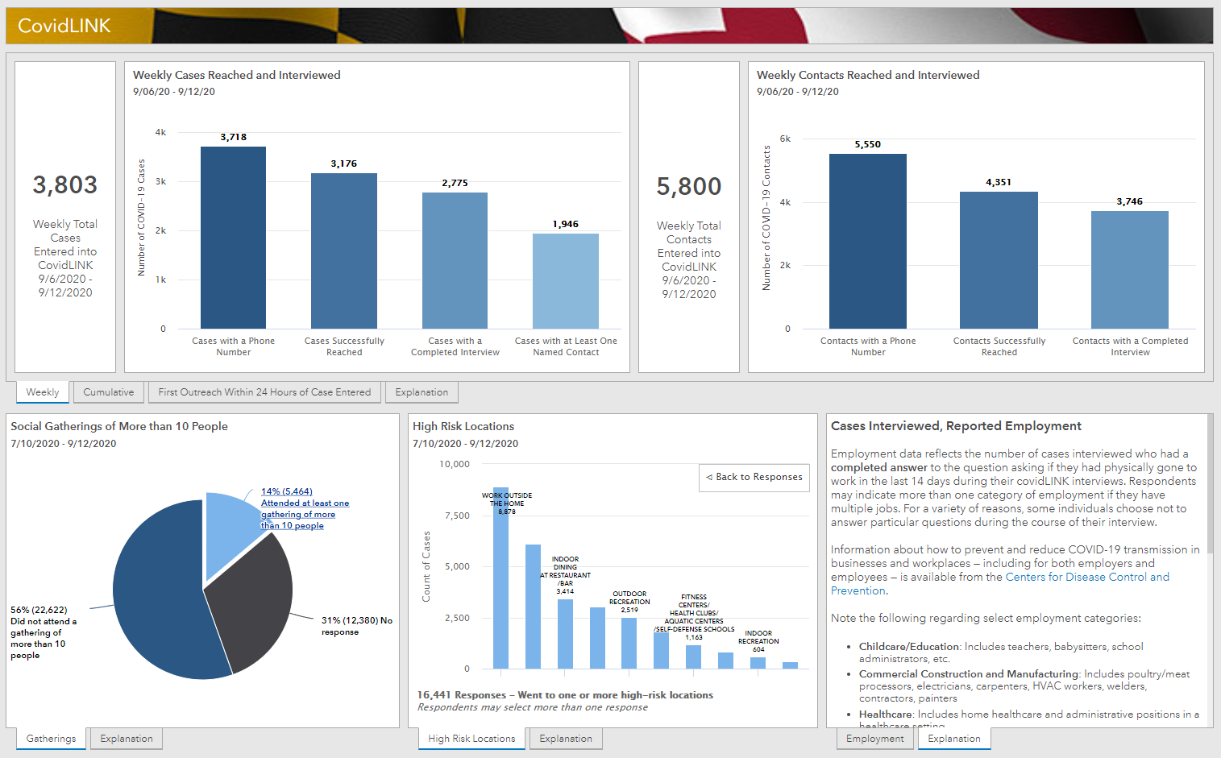
UPDATES > COVID-19 Response
Launched on 03/14, Maryland’s website @ coronavirus.maryland.gov 8,257,235 visitors; 53,527,731 pageviews.
Recent added maps and charts: 7 Day Moving Avg Case Rate per 100k by Jurisdiction; Positivity and Testing by Age Group; and Daily Cases by Age Group. Launched entirely new CovidLINK dashboard New methodology page

Slide 11
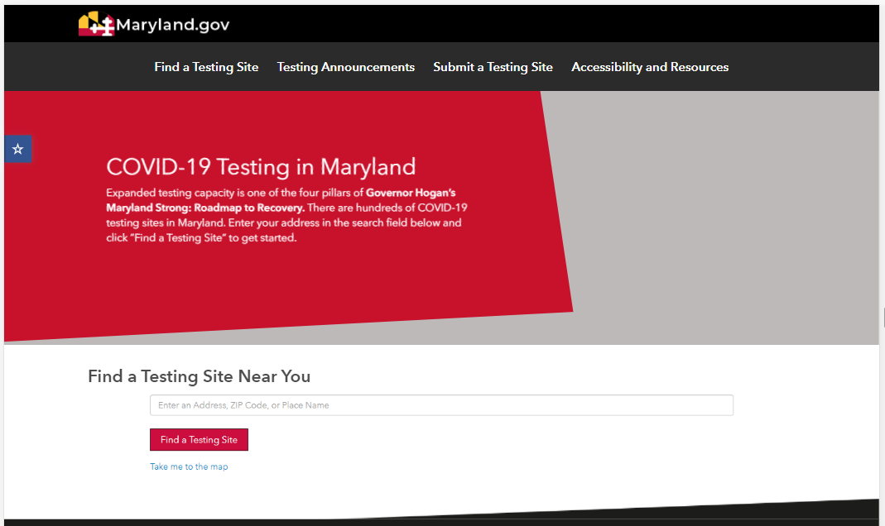
UPDATES > COVID-19 Response
46 datasets are available to explore, visualize and download from Maryland’s GIS Data Catalog and Maryland’s Open Data Portal.
Redesigned testing page
Single address look-up similar to resource in NY and other states;
New sites continue to be added and removed based on current activities.

Slide 12
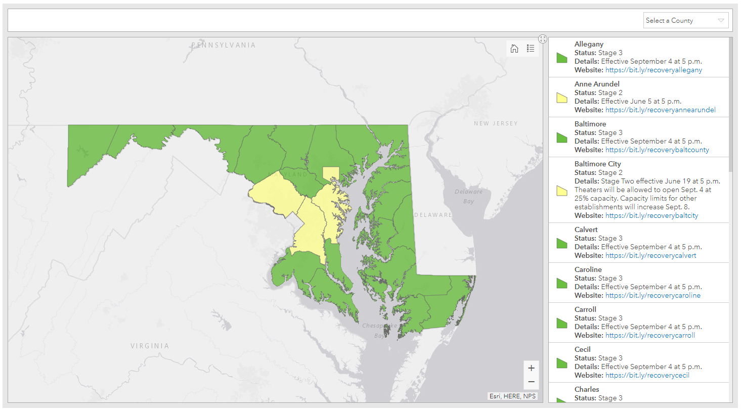
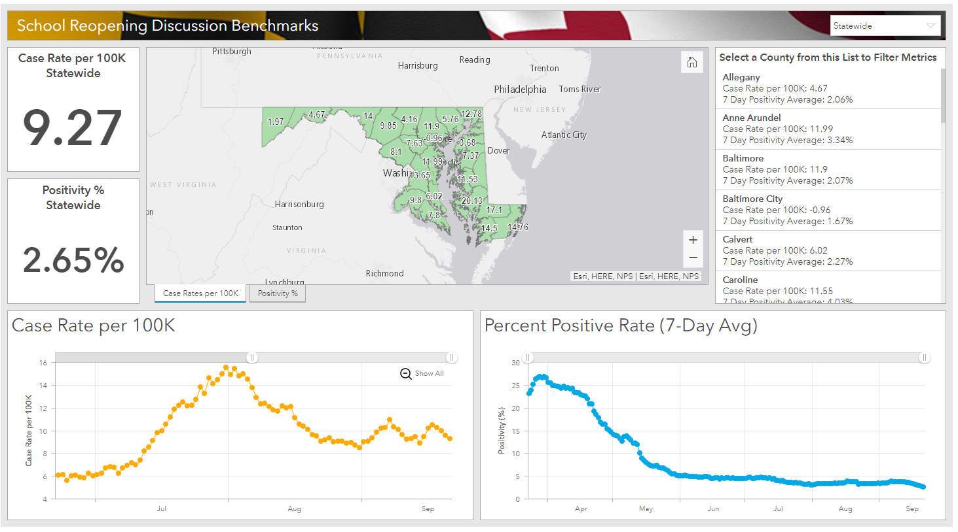
UPDATES > COVID-19 Response
Recovery & Reopening Dashboards

Slide 13
UPDATES > COVID-19 Response
PPE Tracking Dashboard & Early Detection Dashboard
Compile disparate datasets into a single visualization
Reveal trends and highlight conditions for further analysis
Provide decision makers with actionable conclusions
Automate updates to ensure close to real-time reporting

Slide 14
Maryland In the News
August 2020 TUgis Conference - Maryland’s Geospatial Conference Open Data Helps Maryland Safely Re-Open Presented on the geospatial tools to distribute testing locations to constituents. NASACT Conference Pandemics vs. States: Testing Controls in the Wake of COVID-19 Presented on the critical role data plays in state’s response to COVID-19.

Slide 15
Maryland In the News
September 2020 National States Geographic Information Council (NSGIC) GIO Academy Geospatial Response to the Pandemic - Challenges, Resolutions and Lessons Learned Panel discussion with peers nationwide to discuss state’s response to COVID-19. StateScoop Article How Maryland used GIS to build its COVID-19 response website Baltimore Sun Article Maryland releases more contact tracing data showing ‘high-risk locations’ for coronavirus

Slide 16
Maryland In the News
October 2020 Offer for State and Local Government Open Data Sites Share COVID-19 News, Resources (April 2020) article to be included in annual Mapping the Nation book Interview with Director of the Innovations in Government program at the Harvard Kennedy School on the state’s COVID response and associated open data.

Slide 17
Topics from NSGIC 2020 Annual Conference
3DEP for the Nation COVID-19 Technology and GIS Lessons Learned Geo-Auditing the Impact of COVID-19 on Electoral Participation High Resolution Land Cover Through Partnership Impact of Geospatial Search and Analysis in the Transportation Industry Improving Emergency Response with Innovative Geospatial Technology NG9-1-1: NENA Update USGS 3D National Terrain Model

Slide 18
Questions?
MD iMAP Portal @ https://imap.maryland.gov
Maryland’s GIS Data Catalog @ https://data.imap.maryland.gov
Maryland’s Open Data Portal @ https://opendata.maryland.gov

