Slide 1
QGIS Feature Frenzy 18 Features in 20 Minutes
Shawn Pickett

Slide 2
Introduction
Shawn Pickett
Data Analyst
https://www.centuryeng.com/

Slide 3
Agenda
Overview
Feature Frenzy
MD QGIS UG
Q & A

Slide 4
OVERVIEW

Slide 5
What is QGIS?
Free and open source (OS) desktop GIS
C++ / Python
GDAL / OGR
Integration with PostgreSQL / Geoserver
An official project of Open Source Geospatial Foundation (OSGeo)
Runs on - Windows, Mac, Linux, Android
https://qgis.org/en/site/

Slide 6
Terminology/Files
CRS (Coordinate Reference System)
Processing [Algorithms] => Geoprocessing Tools
Project File => Map Document
.qgs – Stand Alone
.qgz – Zipped .qgs with .qgd (auxillary data)
Layers / Layer Files
.qml – Layer Style File
.qlr – Definition Layer File (.qml with data pointer)
https://docs.qgis.org/3.10/en/docs/user_manual/introduction/project_files.html

Slide 7
Properties / Variables
Auxillary Data (.qgd)
.qgs / .qgz
SAVED WITH
OPENS
JOINED ONTO
CONTAINS
LOADS GLOBAL SETTINGS FROM
.qml
Layer(s)
PROPERTIES CAN BE STORED IN
POINTS TO
.qlr
Data
POINTS TO
Current Profile

Slide 8
Interface
MENU BAR
TOOLBARS
PANELS
STATUS BAR
MAP VIEW(S) (2D / 3D)

Slide 9
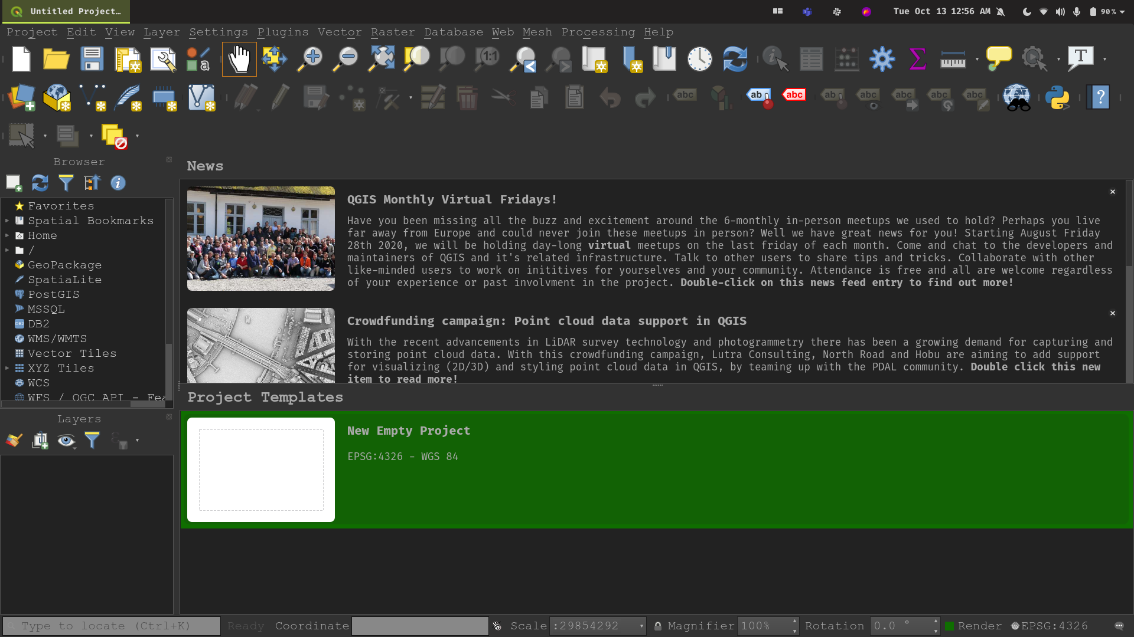
Customization (Settings)
Options
Font
Icon Size
Style
Interface Customization
Menus and Toolbars
Data Providers
User Profiles
Manage
Switch

Slide 10
Data - Types
Raster
Vector
Mesh
2.5D / 3D
Temporal

Slide 11
Data - Formats (Vector/Raster)
Vector
Shapefile
DXF / DGN / DWG*
KML
CSV / XLSX
GeoJSON
Vector Tiles
Raster
JPEG / GeoTIFF / PNG
Erdas Imagine
Idrisi
Mbtiles

Slide 12
Data - Formats (Databases/Web)
Databases
Geopackage
File Geodatabase
PostgreSQL
Oracle
SQL Server
DB2
Web
OGC Web Services (WMS / WMTS / WFS / WCS)
ESRI REST Services (Map, Feature, Image)
XYZ
Vector Tiles

Slide 13
Other Features
Model Builder
PyQGIS => arcpy
Scripts
Expression Builder
Plugins
QGIS Server
QField / Input (separate projects)

Slide 14
Development Life Cycle
Version numbering convention:
Even numbers (3.10, 3.14 etc) Release
Odd numbers (2.99, 3.1 etc) Development
Release Types:
Long Term Release (LTR) – 3.10.x
New LTR annually – February
Point releases monthly
Latest – 3.14.x
Minor releases every 3 – 6 months
Point releases monthly
https://www.qgis.org/en/site/getinvolved/development/roadmap.html

Slide 15
Help Documentation
LTR:
https://docs.qgis.org/3.10/en/docs/user_manual/
Latest: https://docs.qgis.org/testing/en/docs/user_manual/

Slide 16
FEATURE FRENZY

Slide 17
CARTOGRAPHY

Slide 18
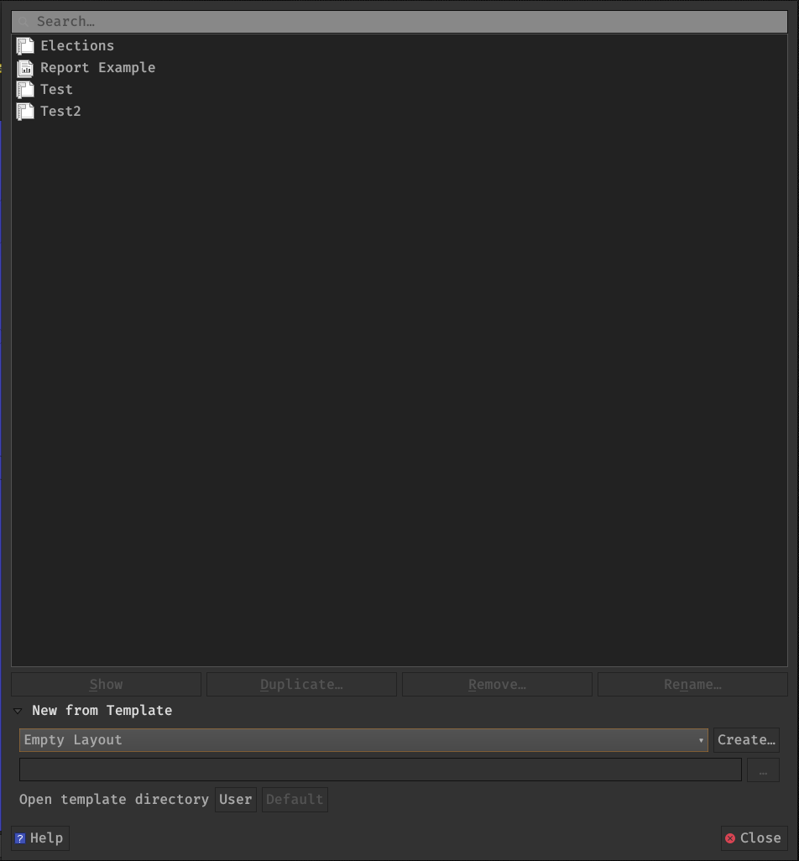
Layouts
Project → Layouts → Pages
Layouts => Maps+
Single Page
Multi-Page
Atlas
Pages
Orientation
Paper Size
Map Views
Layout Manager

Slide 19
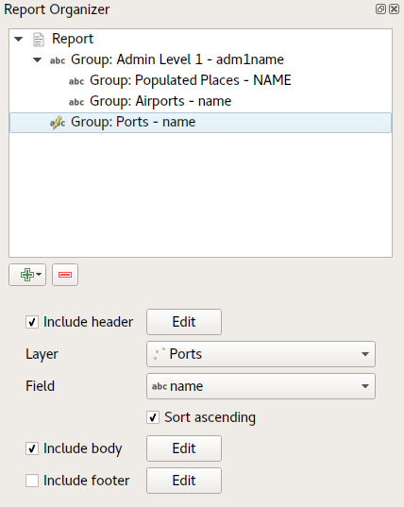
Reports
Header
Nested / Stacked
Static Layout Section
Field Group Section
Header
Body
Footer
Footer
https://north-road.com/2018/01/23/exploring-reports-in-qgis-3-0-the-ultimate-guide/

Slide 20
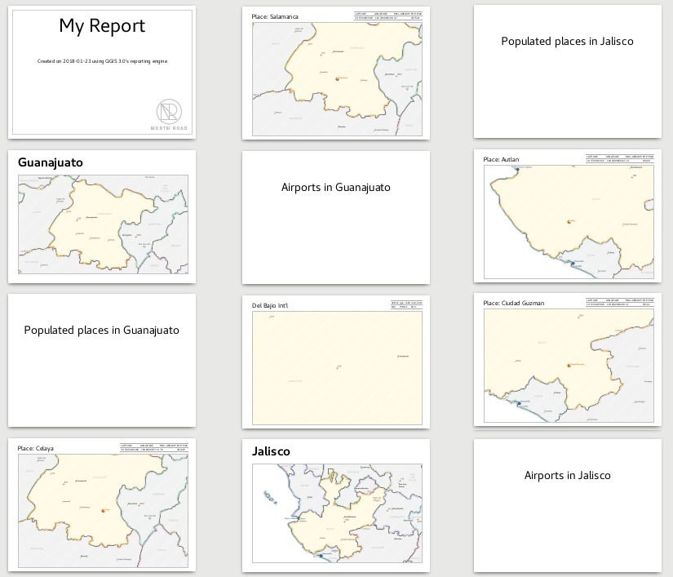
Reports - Example
Header
Header
Header
Header
Header
https://north-road.com/2018/01/23/exploring-reports-in-qgis-3-0-the-ultimate-guide/

Slide 21
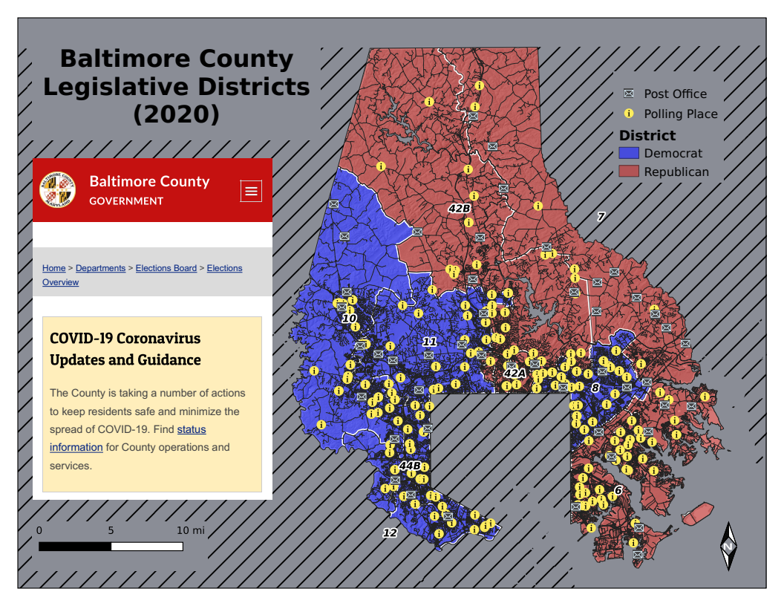
Content
2D / 3D Map View(s)
Legend
North arrow
Scale Bar
Neat line
Text
HTML (website)
Attribute Table
Filtered by Map/Query
Select Fields displayed
https://docs.qgis.org/3.10/en/docs/user_manual/print_composer/composer_items/index.html

Slide 22
ATTRIBUTES / EDITING

Slide 23
Forms
Data Validation
Input Widget
Drop-down
Date Picker
Text Box
Number Combo Box
Attachment
Constraints
Default Value
Organize Columns
Change Alias
Toggle if Editable
Toggle Visibility
Reorder
Group into:
Sections
Tabs
https://docs.qgis.org/3.10/en/docs/training_manual/create_vector_data/forms.html?highlight=attribute%20form

Slide 24
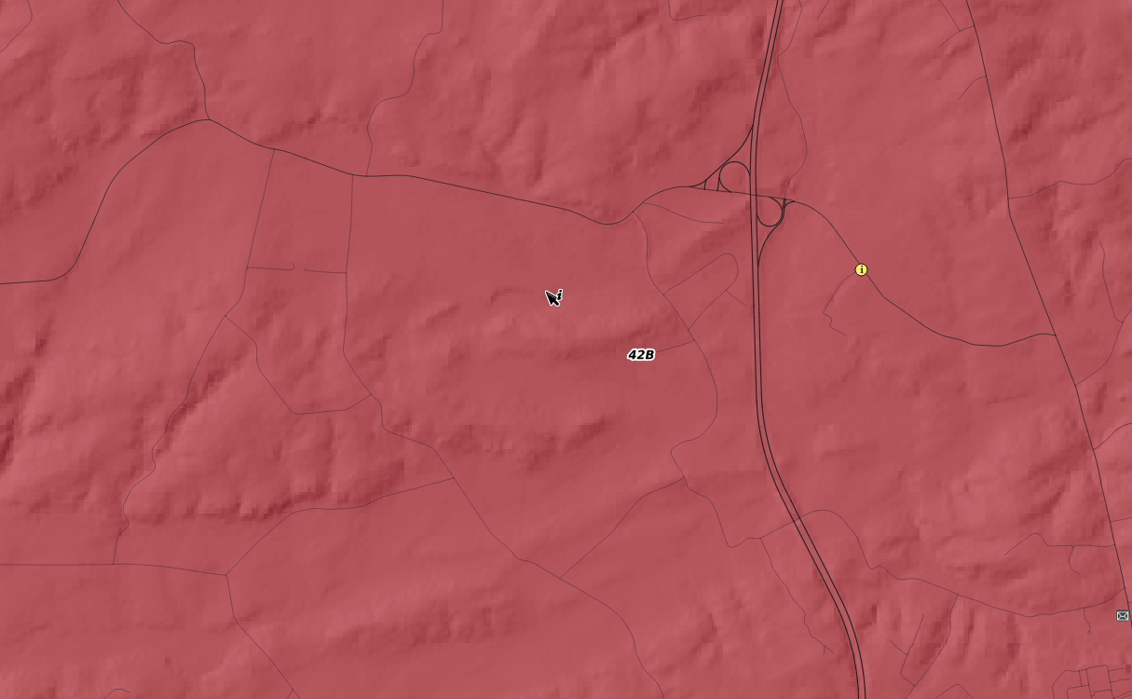
Forms

Slide 25
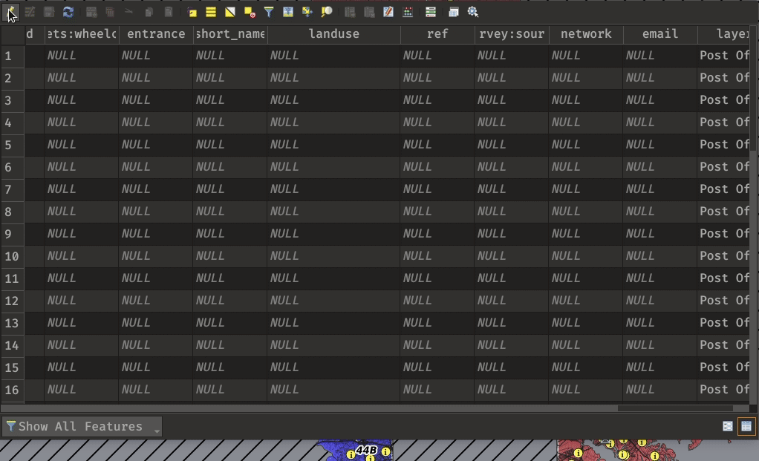
Quick Filtering / Calculating

Slide 26
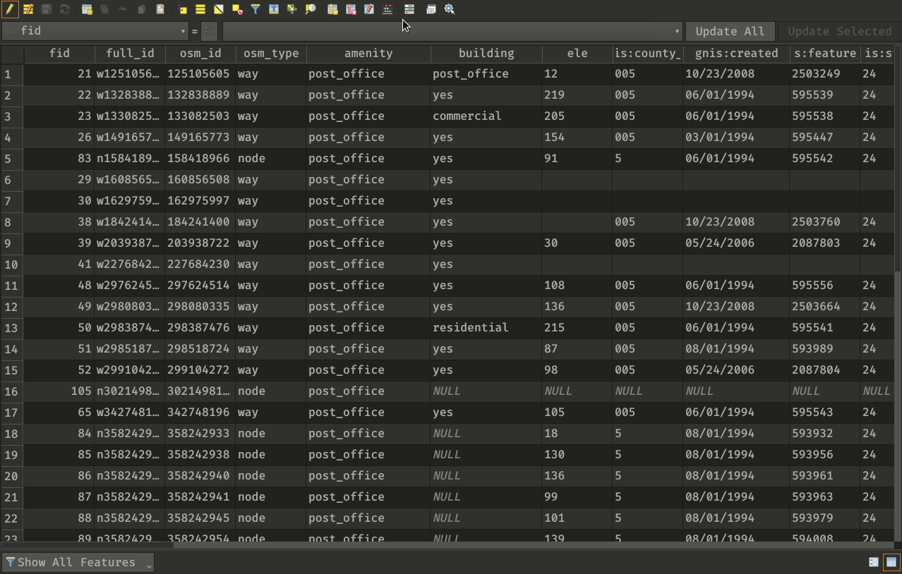
Conditional Formatting

Slide 27
SYMBOLOGY

Slide 28
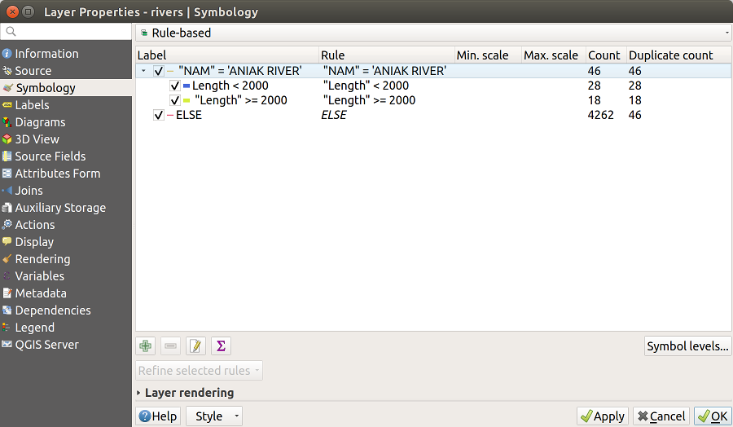
Rule-Based Renderer
https://docs.qgis.org/3.10/en/docs/user_manual/working_with_vector/vector_properties.html?highlight=rule%20based#rule-based-renderer

Slide 29
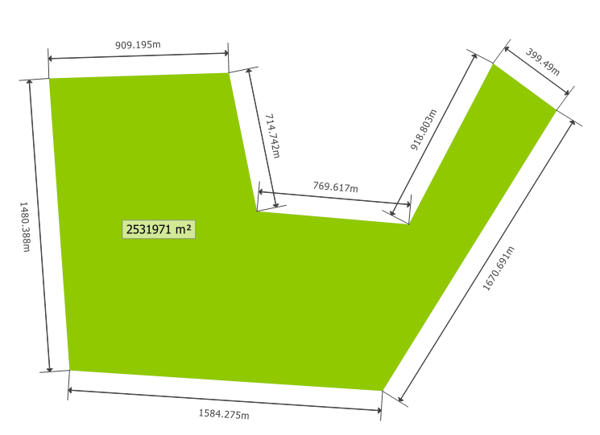
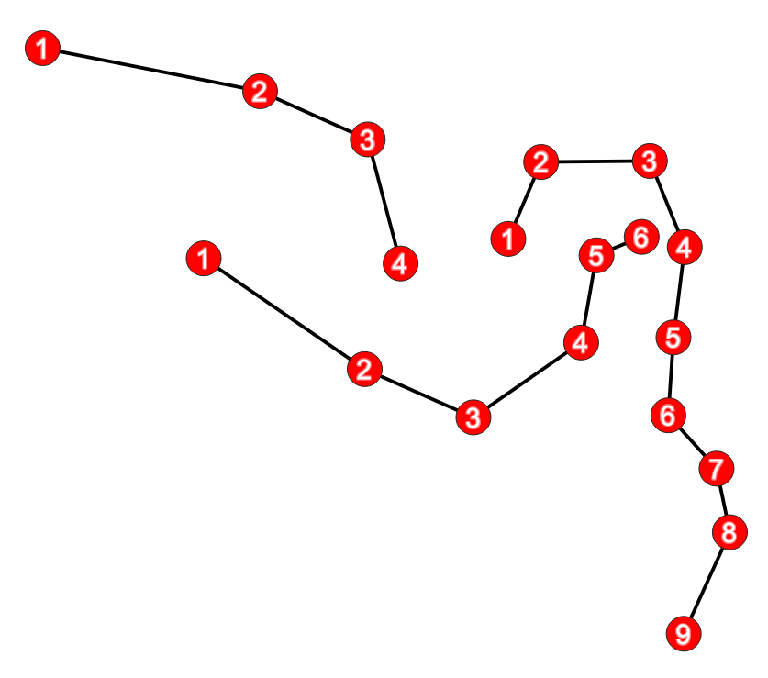
Geometry Generator
https://gitlab.com/GIS-projects/qgis-geometry-generator-examples
https://docs.qgis.org/3.10/en/docs/user_manual/style_library/symbol_selector.html?highlight=geometry%20generator#the-geometry-generator

Slide 30
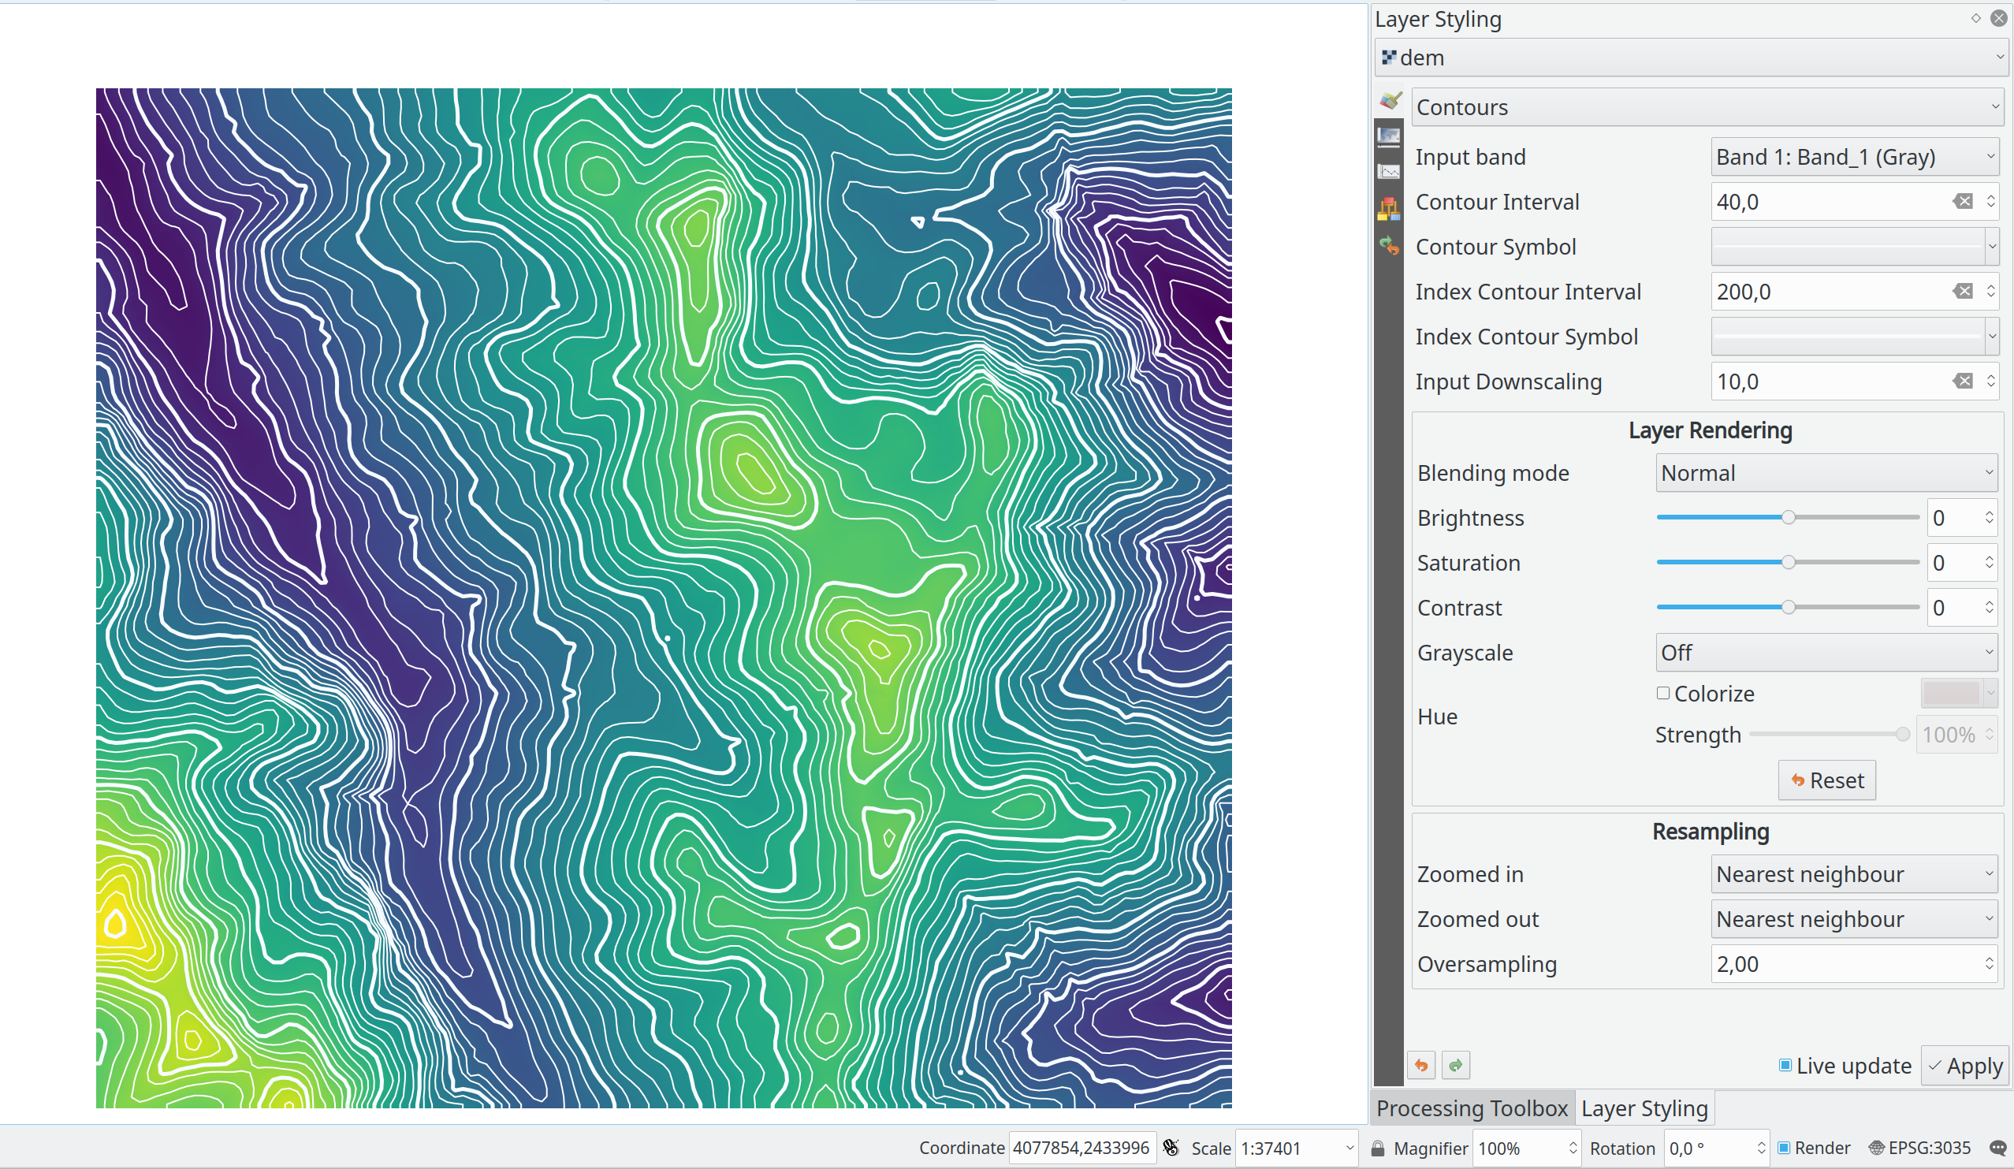
Contour Renderer
https://qgis.org/en/site/forusers/visualchangelog314/index.html#feature-raster-layer-contour-renderer

Slide 31
LAYERS

Slide 32
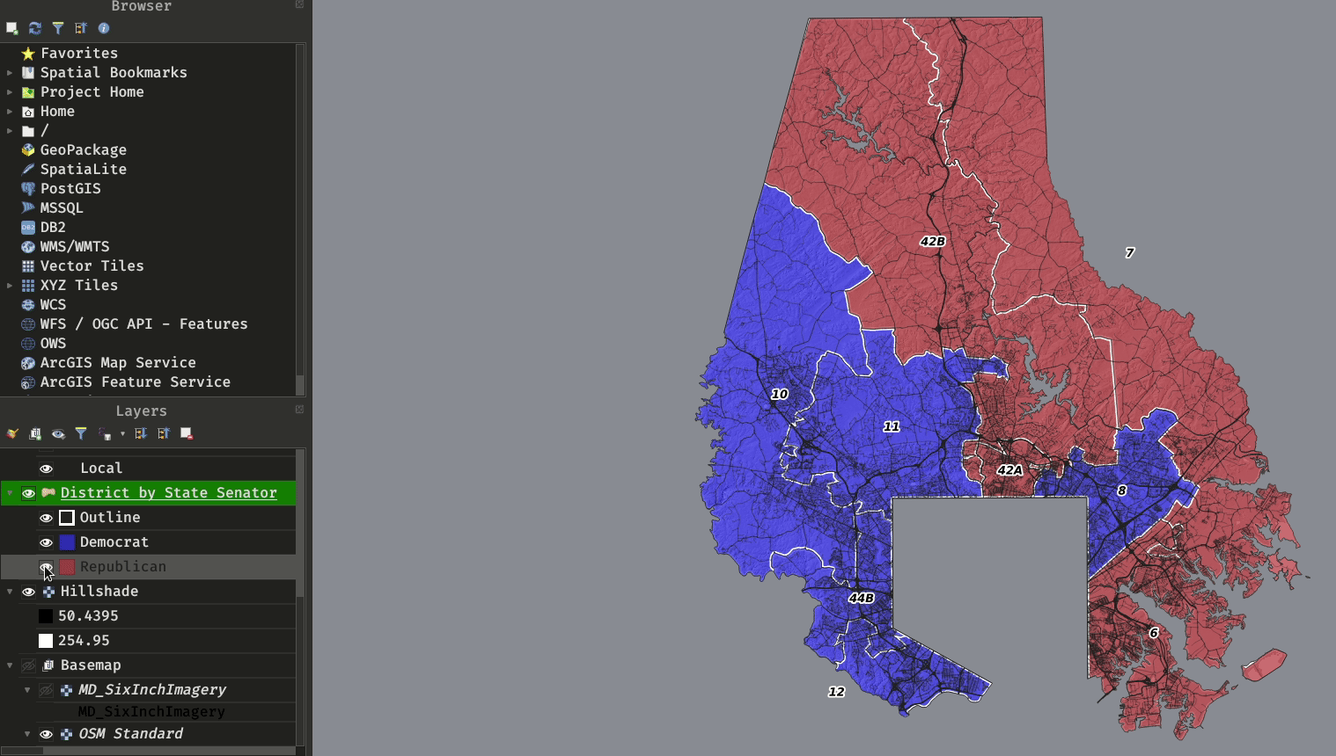
Toggle Categories

Slide 33
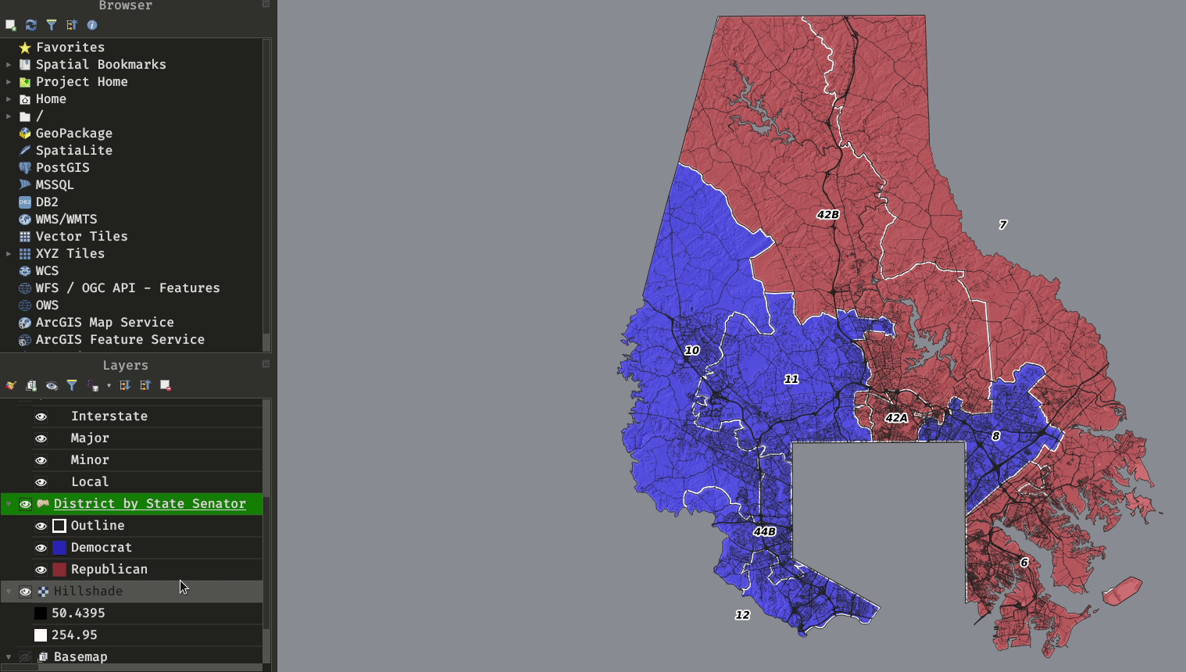
Multiple Styles

Slide 34
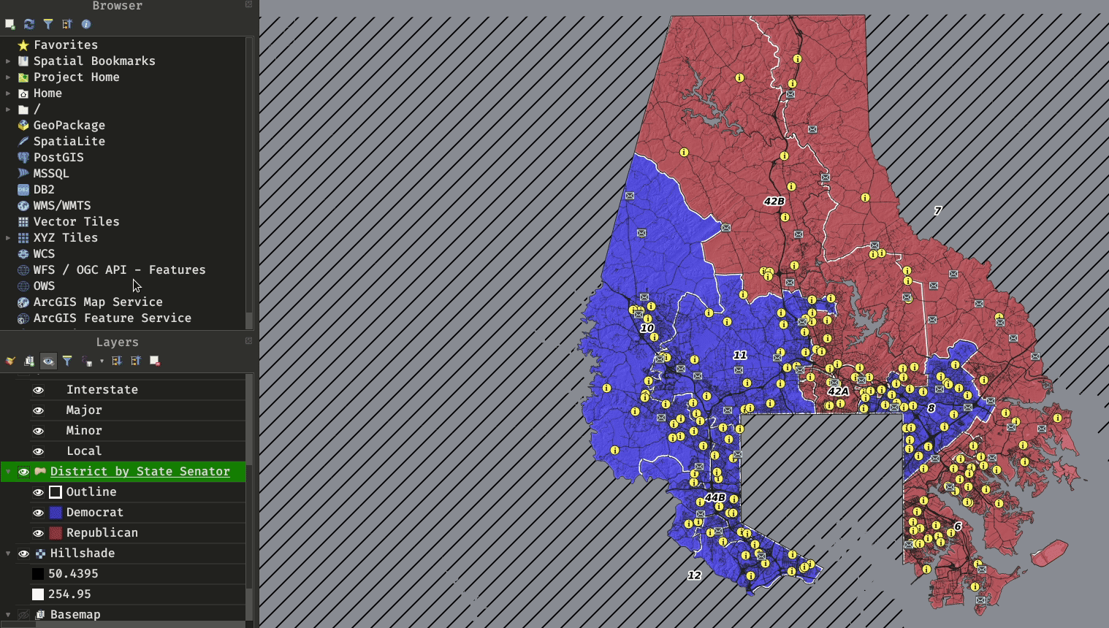
Map Themes

Slide 35
GEOPROCESSING

Slide 36
Append Results to Layer
https://qgis.org/en/site/forusers/visualchangelog314/index.html#feature-allow-appending-processing-results-to-existing-layers

Slide 37
Limit # of Features
https://qgis.org/en/site/forusers/visualchangelog314/index.html#feature-expose-per-feature-source-advanced-options-for-processing-inputs

Slide 38
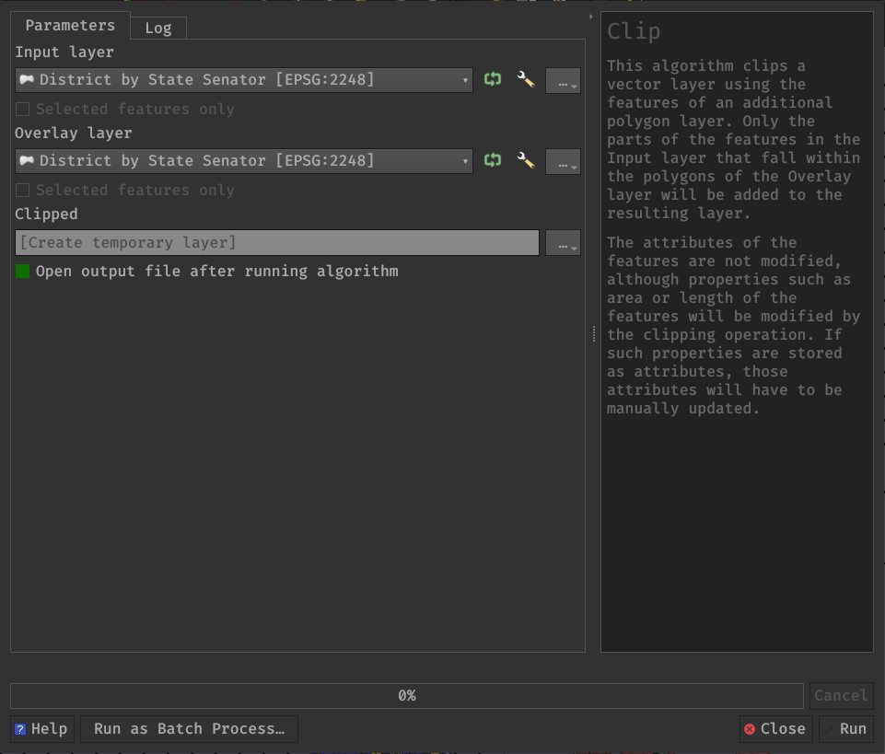
Process Selected Features Toggle

Slide 39
GENERAL

Slide 40
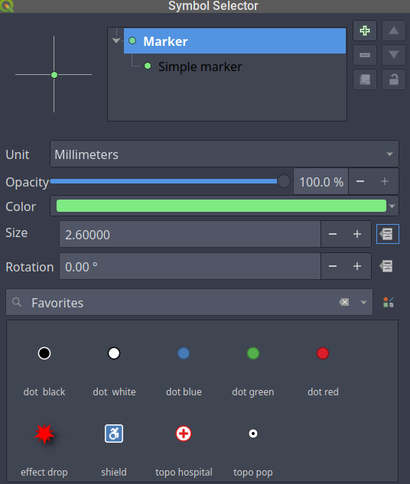
Data Defined Overrides
Use either:
Field Value
Variable (Global/Project/Layer)
Expression
Auxillary Data
Set here:
Layers
Symbology
Labeling
Diagrams
Processing Tools
Print Composer
https://www.youtube.com/watch?v=h-mpUkwDdOQ

Slide 41
Expression Builder
Use Cases
Select by Expression [Attribute]
Field Calculator
Symbology / Labeling
Data Defined Override
Attribute Form Builder
Alias
Constraints
Default Value
Conditional Visibility (sections)
https://docs.qgis.org/3.10/en/docs/user_manual/working_with_vector/expression.html

Slide 42
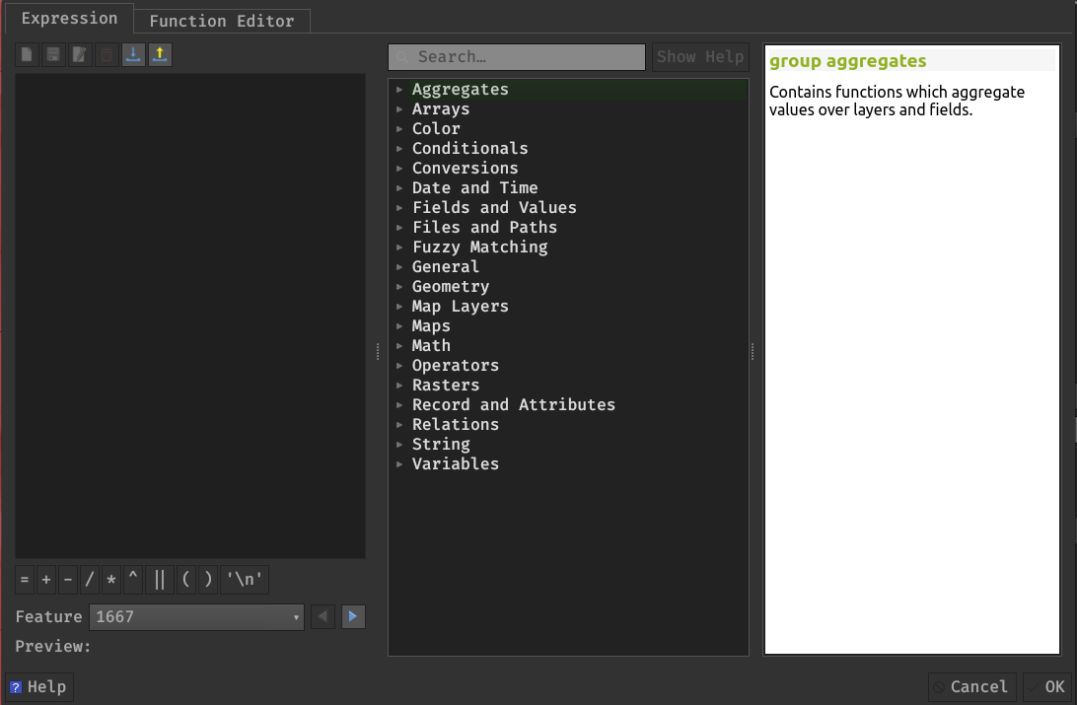
Expression Builder
Notable Function Sets
Fields and Values
Files and Paths
Geometry
Map Layers
Record and Attributes
https://docs.qgis.org/3.10/en/docs/user_manual/working_with_vector/expression.html

Slide 43
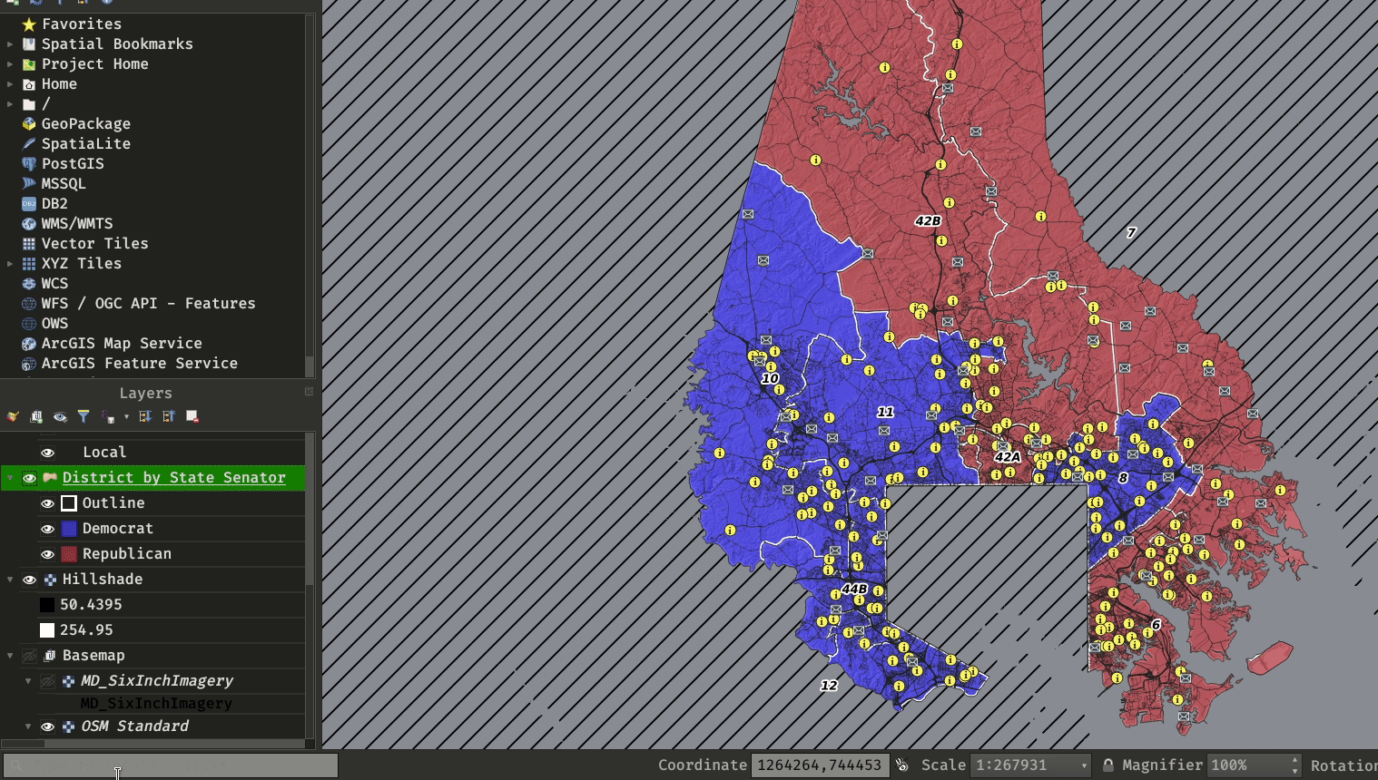
Locator Bar

Slide 44
MD QGIS User Group

Slide 45
Overview
Foster a community around the use of QGIS within the state and promote related open-source technologies
Co-Chaired with Anne Canoune (Century Engineering)

Slide 46
Lunch and Learn
3rd Wednesday of Month
Sept 16th – Attribute Form
Oct 21st – 30-minute Map
Nov 18th – 3D in QGIS
qgismd@gmail.com

Slide 47
QUESTIONS?
spickett@centuryeng.com
This slide template is licensed under a Creative Commons Attribution-ShareAlike 3.0 Unported License. It makes use of the works of Kelly Loves Whales and Nick Merritt.

