Slide 1
Maryland Higher Education Emerging Professionals Engagement Session with MSGIC
March 10th & 11th, 2021

Slide 2
Agenda
Who is MSGIC?
Why now?
How can MSGIC help support
emerging professionals (EPs) within your institution?
Next steps...

Slide 3
Who is MSGIC?
Maryland State Geographic Information Committee
Dates back to April 1974 - Department of State Planning became one of the first State agencies in the nation to implement a Geographic Information System (GIS)
Governed through bylaws, caucuses, and sub-committees
Membership-based, comprised of individuals across all sectors
Registered 501C3 non-profit organization

Slide 4
MSGIC...
Promotes:
Coordinated development and efficient use of resources amongst all entities involved in collection and/or use of spatial data and GIS technologies.

Slide 5
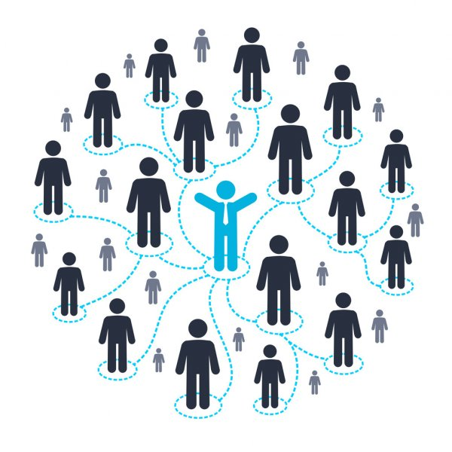
Networking
Quarterly Meetings
Rotate across MD
Discuss updates in MD geospatial community
Pre- and Post-Meeting Networking
Lunch with fellow MD GeoGeeks
Post-Quarterly Meeting Socials
Happy Hours
Community Service Events*

Slide 6
Training
Multiple trainings per year
Included in annual membership
Growing Library of Training Materials
Recent Topics Include:
Python
ArcGIS Pro
Spatial SQL
Topographic Lidar
GISP Certification Prep
https://msgic.org/training/

Slide 7
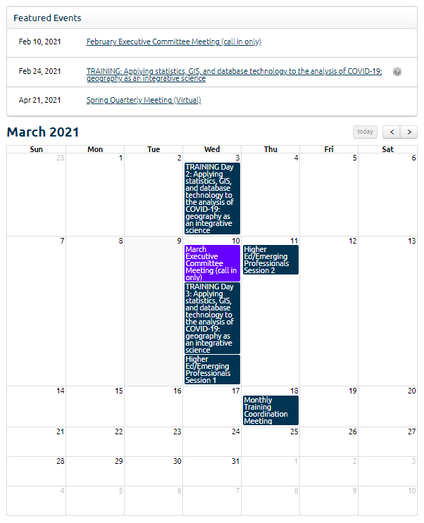
Events Calendar
Executive Meetings
Conferences
Job Fairs
Trainings
Non-MSGIC training
Meet Ups
https://msgic.org/event-calendar/
Submit your own events!!

Slide 8
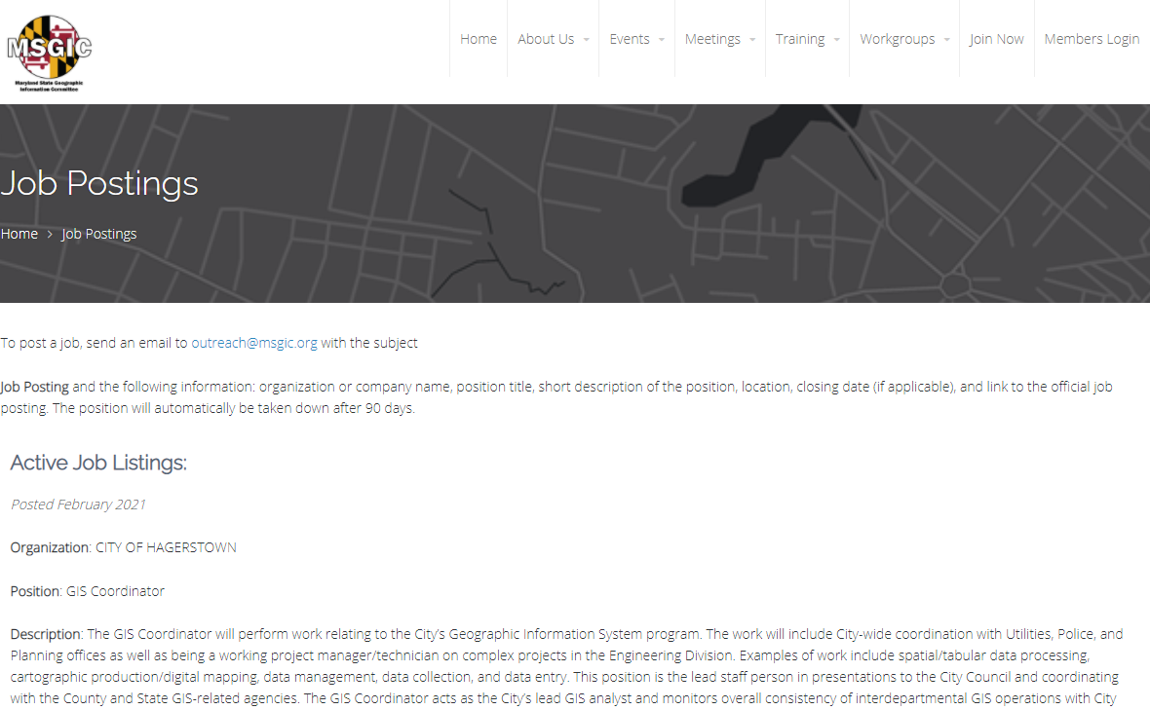
Jobs Board
Exclusive list of jobs and internships
Regularly updated
Must be member to view complete list
https://msgic.org/jobs-internships/

Slide 9
Emerging Professionals Group
The focus of the working group is to facilitate engagement through volunteers interested in giving back to the Geospatial community in support of those individuals working to break into the field of GIS. The only requirement for participation is a passion for fostering the growth and development of individuals seeking a career in the field of GIS.
https://msgic.org/emergingprofessionals/

Slide 10
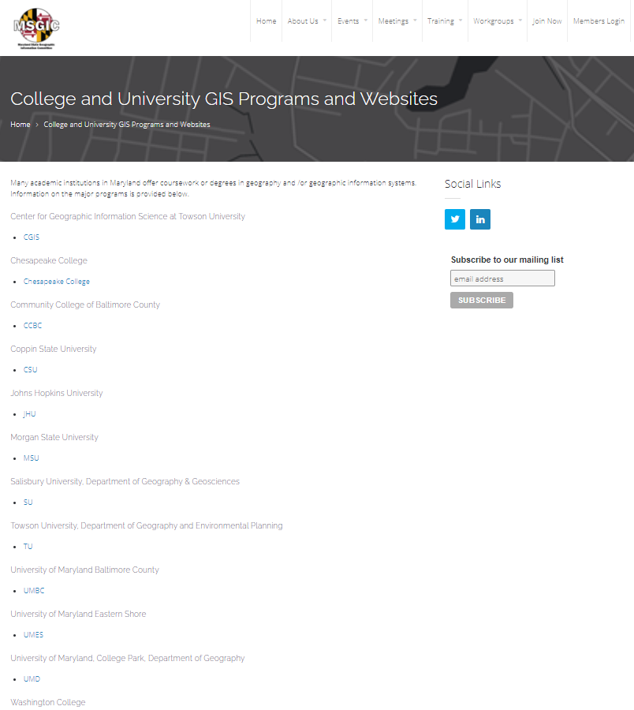
Why now?
COVID 19 forced EP working group to determine other ways to connect with EP’s, beyond in-person sessions
Conducted series of virtual lunch and learns with favorable feedback
Virtual meetings provide greater access and allow MSGIC EP working group to reach larger audience
Not all academic institutions were being served and/or supported

Slide 11
Short Term Goals
Expand engagement with all academic institutions to extend reach to more EP's
Update MSGIC website with a more complete list of partnering institutions - MSGIC website on education needs your input! https://msgic.org/collegiate/
Deliver a series of GIS-centric lunch and learn sessions for emerging professionals across all academic institutions geared to major/discipline

Slide 12
Long Term Goals
Increase membership and job placement successes for EP's that leverage MSGIC
Implement continuous improvement model that adjusts and refines EP offerings based on regular feedback from EP's, Industry Professionals, and Academic Institutions
Spur more diversity in the types of emerging professionals considering the Geospatial Industry as a potential career path

Slide 13
Next Steps
Fill out survey, provide linkage and contact for MSGIC website to promote a given academic institution’s GIS program(s)
Update MSGIC website accordingly
Initiate series of virtual lunch and learns (~April/May 2021)
GIS for Engineering/Utilities
GIS for Environmental
GIS for Transportation/Planning
GIS for Health and Human Services
TBD
Schedule breakout sessions for EP’s focused on various topics

Slide 15
Open Discussion
Working together, how can we help support the growth of your GIS program and increase the number of students converting to full-time jobs upon graduating?
Working together, what types of tools, data, programs, resources, or partnerships would serve emerging professionals that are looking for additional support transitioning to the workforce?

Slide 16
A look ahead…
Lunch and Learns for Emerging Professionals by discipline/major - April/May 2021
MSGIC Spring Quarterly meeting - April 21st, 2021
EP Break-out Sessions with Colleges/Universities - May/June 2021
MSGIC Summer Quarterly meeting - July 2021
TUGIS Conference - August 10th-13th, 2021
Includes session for emerging professionals sponsored by MSGIC
Training opportunities
MSGIC Fall Quarterly Meeting (Annual Meeting) - October 2021
EP Lunch and Learns by discipline/major - November/December 2021

Slide 17
Become a MSGIC Member
• Contribute to and receive support from the GIS community in Maryland
• Participation in interest-specific working groups
• Knowledge sharing opportunities through presentations
• Advanced notice of upcoming GIS events
• Access to MSGIC-sponsored training events
• Networking opportunities
• Access to membership lists and profiles
• Free job postings for employers and access to job listings for job seekers on MSGIC’s website
• Record of membership for professional certifications

Slide 18
How to join MSGIC…
Go to : https://msgic.org/join-msgic/
Chose membership level
Student - $10.00
Individual - $50.00
Organizational - $200 - $300

