Slide 1
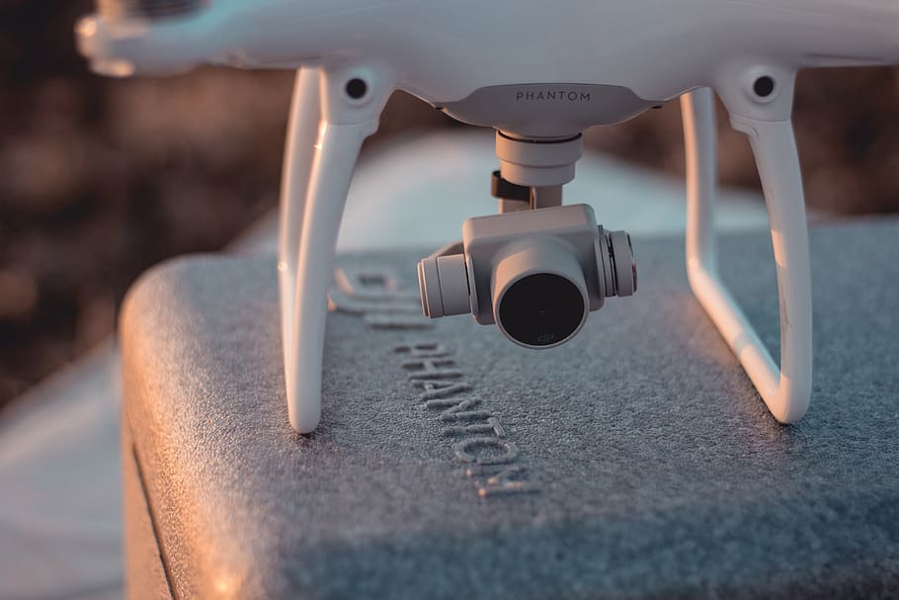
Free and Open Source Drone Mapping
You bought a drone. Now what?

Slide 2
Audience
If you are a drone or aerial imaging services provider, this is not for you
If you need high spatial accuracy, this presentation doesn’t fully cover that
(High accuracy is possible with ground control points)
This is for you if you are a GIS analyst and interested in drones
This is for you if you are interested in open-source alternatives

Slide 3
Who is Dave
1995 Degree in Computer Networking (dial up internet era)
2005 Degree in Geography with emphasis in GIS and Remote Sensing (Google Maps Begins)
2005 – 2009 GIS Systems Engineer – Imagery Analysis Workflows
2009 – 2012 Geospatial Medical Intelligence Analyst
2012 – 2013 Road Trip! Trail Business (DJI Phantom 1 Released)
2014 – Now – Utility Asset Management with Baltimore DPW

Slide 4
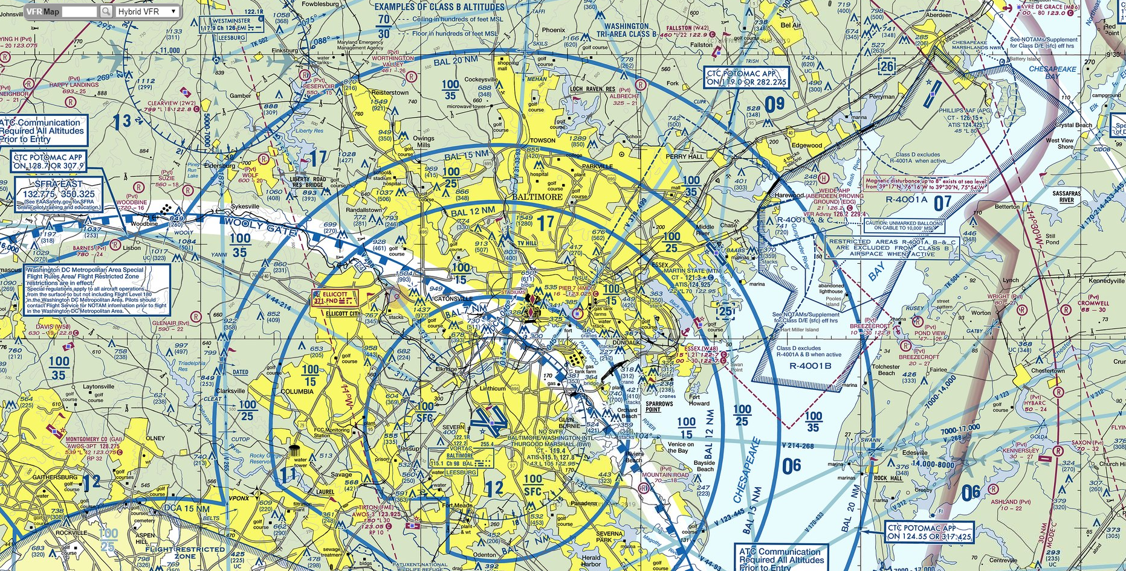
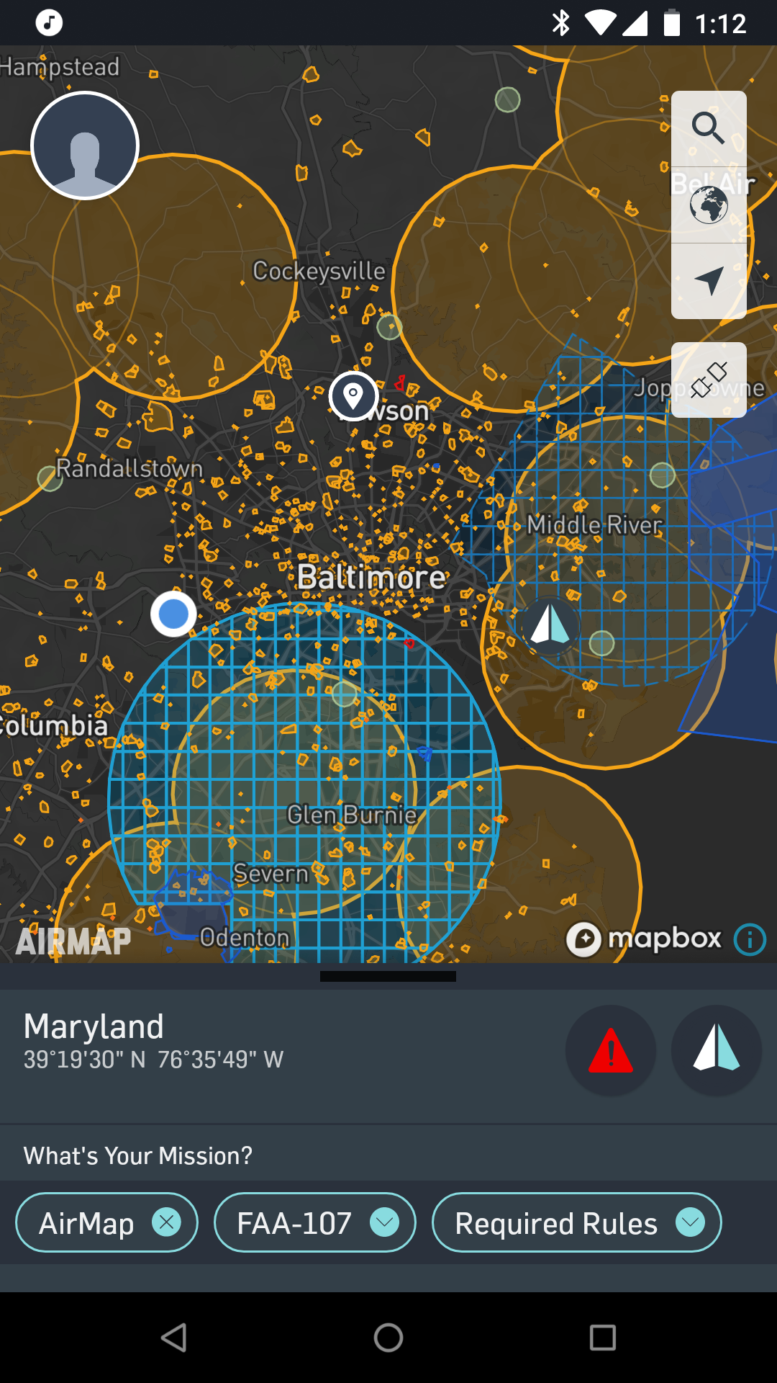
Can I fly?
Flying for any commercial purpose requires a part 107 pilot certificate
The airspace must be open to drone operations
The drone must be in your visual line of site
You will learn all the rules as part of your part 107 training

Slide 5
Free resources used in this presentation
Air Map’s free service to check air space
Drone Deploy’s free tier for mission planning and flight control
Open Drone Map for local processing
Run in a docker container for free
Bootable Linux Image with web interface for $50

Slide 6
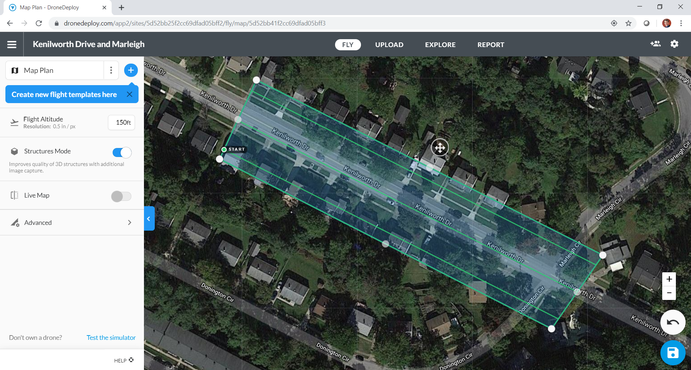
Flight Planning
Plan the flight in Drone Deploy
Draw a box around the area you want to map
Set some options for simple orthos or enhanced 3d
If you want both, plan two flights.
(Notice that we are not placing ground control points – this limits spatial accuracy)
Notes:
Drone Deploy makes this easy. Choose your mission type and draw a box.
It will estimate the number of images to take and the number of batteries required to complete the mission.
Smaller missions with fewer images will process faster
Higher altitude covers the same ground in fewer images
Drone Deploy is free for this purpose but offers other paid services

Slide 7
Flight Execution
Check the airspace again for ‘Temporary Flight Restrictions’. Check the weather for winds < 15mph
Prefly to altitude and check for vertical obstructions
Execute the flight with Drone Deploy
Automated take off, pattern, and landing
You must be ready to take control
Review the images before you leave the site
Notes:
TFR – Temporary Flight Restrictions pop up all the time. Air Force One, Major Sporting Events, Wild Fires, etc.
Don’t count on the drones obstacle avoidance system. Make sure the area is clear at your operating altitude.
Drone Deploy will operate the whole flight from take off to landing but you must be ready to take over.

Slide 8
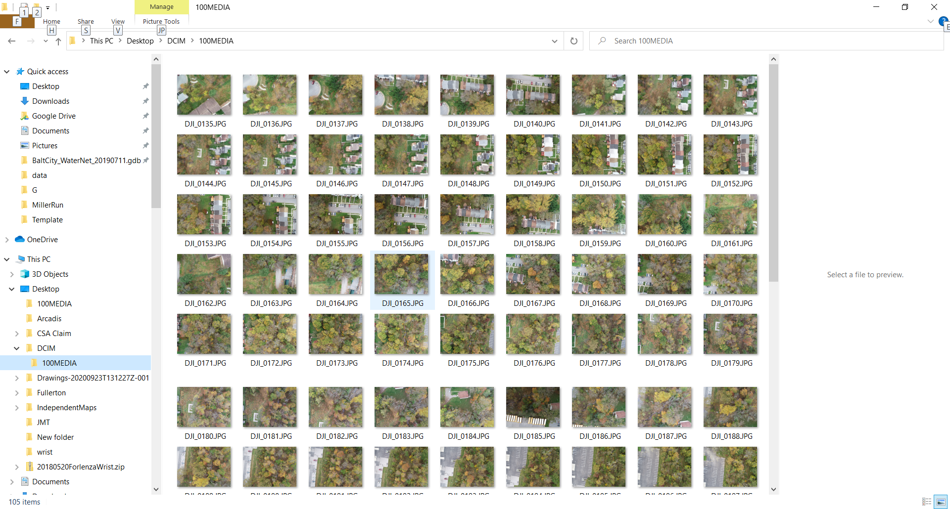
Review images before leaving the site
Notes:
You don’t want to go home to an empty SD card.

Slide 9
Drone Image vs Georeferenced Image
Satellite images ship with georeferencing information in the metadata. At the very least you will get bounding coordinates.
Drone images have a single point for camera location. This point is not precise
You cannot directly drop a drone image in your map
A drone ortho mission will include many images, each with a point. Open Drone Map will use all those points and edge match all of those images to create an ortho

Slide 10
Processing Environment
Open Drone Map is linux and python based
Docker images are available for free or you can purchase a bootable ISO for $50
Open Drone Map favors parallel processing. More cores + more ram + fast IO = faster processing
My low budget example
Older workstation class laptop, 4 cores, 16GB of RAM, booting and running from SS USB port
150 image orthos process in a few hours.
Notes:
Last time I checked ODM did not leverage the GPU

Slide 11
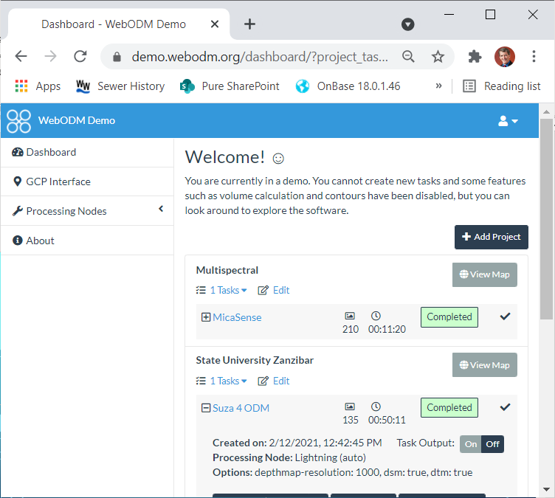
Processing
Review and remove all images that should not be in the ortho
Images from another mission, ground shots, family photos, …
Upload the images and select ortho or 3D model, and/or a dem
Wait several hours while it processes
Download the results to your GIS workstation
Notes:
Sorry – I didn’t take my drone processing environment on vacation so their isn’t much detail here.
It is easy. Add a project, add the images, select ortho and that is what you will get at the end.

Slide 12
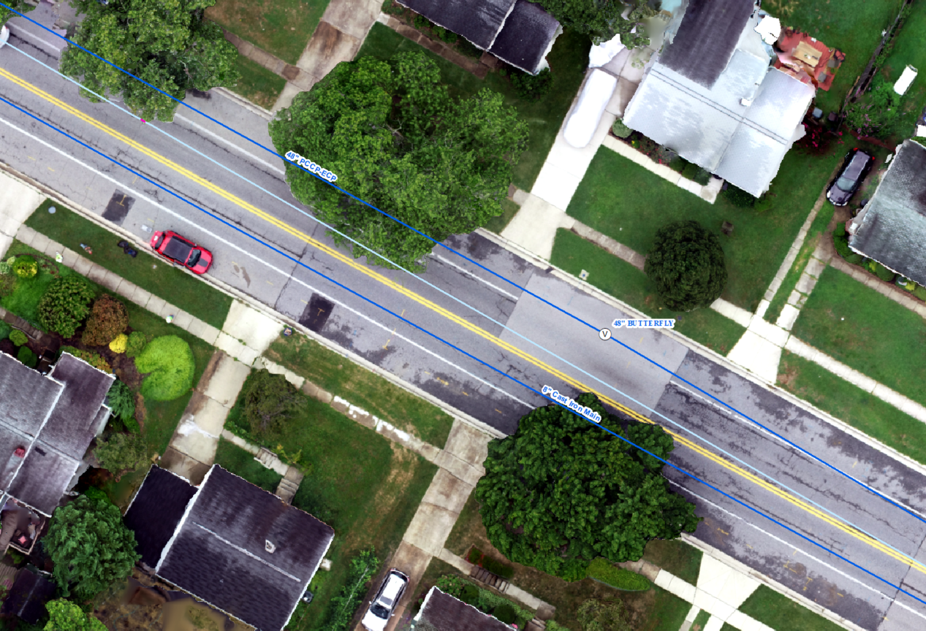
Drone Ortho at Kennilworth Avenue
Valve Reported by Internal Inspection
Valve in GIS
Possibly Paved Over
Dave & Amr
New Pavement
Miss Utility Marks for Water and Gas Visible
Notes:
Roughly 1 inch spatial resolution
Clear enough to see Miss Utility paint in the street
Clear enough to see joints in the sidewalk
Clear enough to see Dave and Amr standing on that sidewalk

Slide 13
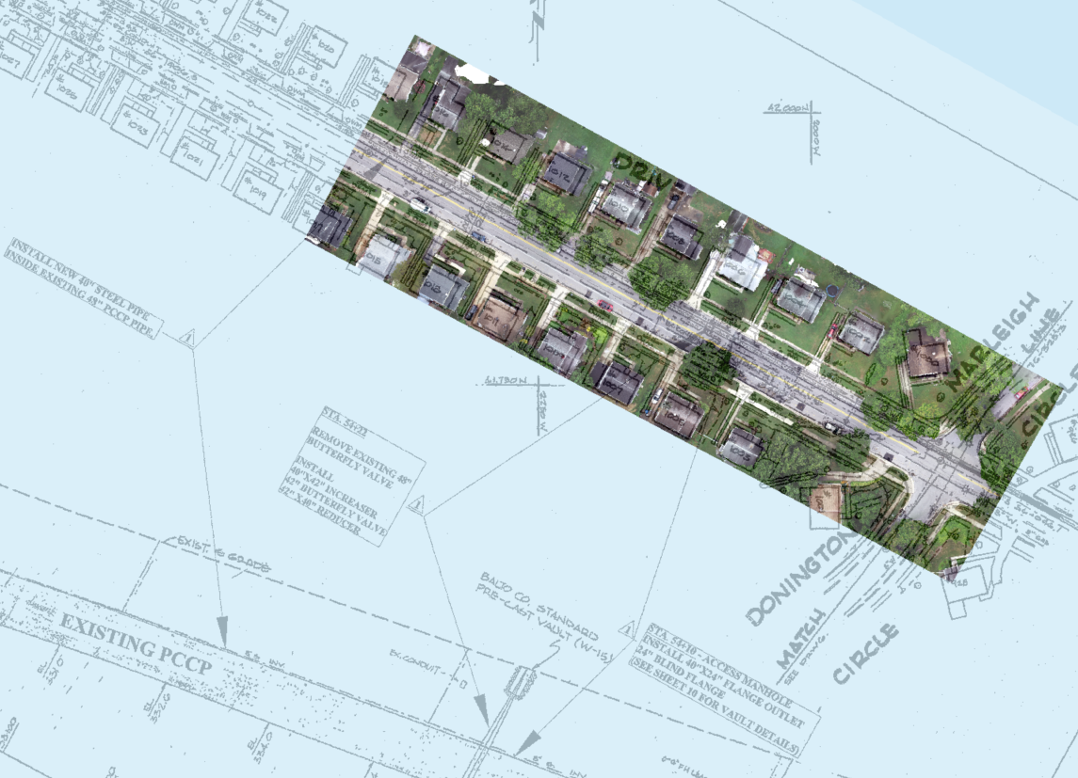
Drone Ortho at Kennilworth Avenue
Valve in Drawing
Possibly Paved Over
Detail Sheet Calls for
30” Lid for Flanged Access Manhole
18” Lid for Valve Actuator

Slide 14
High Resolution is not High Accuracy
So far this workflow relies on uncorrected GPS data from the drone
In my experience this is good to about 3 feet
For high spatial accuracy you have choices
RTK GPS equipped drones and ground station starting at ~$9000
Place visually distinct targets on surveyed points

Slide 15
Drone Safety
Got insurance? Most job sites require a million dollar liability policy.
Protocols must be in place and practiced for
- Lost Link – If the control link is lost, where will the drone go?
- Lost GPS – What will the operator do if drone flies off course?
- Low Battery – What will the drone do when a low battery is detected?
- Return to home – Default settings may violate airspace.

Slide 16
Final Thoughts
Start with your mission goals. What do you want to know?
What will the inspections products be? Reports? Photos? Maps?
Evaluate your options. Is a drone the right tool for the job?
Asset Management is a long game. Make sure the next generation of engineers can discover and read your work.

Slide 17
END
Discuss paid alternatives
Drone Deploy, Pix4d, ESRI

Slide 18
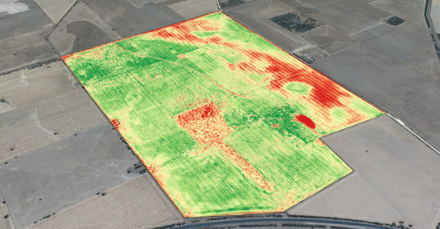
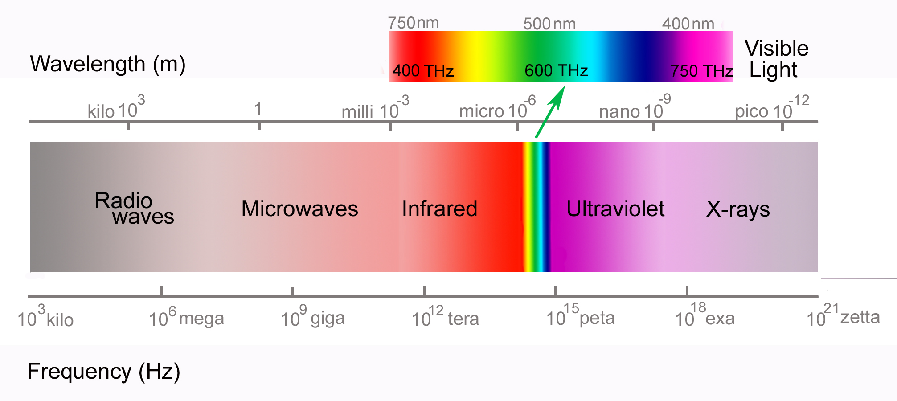
Sensors: Near IR, NDVI
Adds Near Infrared to traditional Red, Green, Blue cameras
Wavelengths detected are just bit longer than what the human eye can see
First application was camouflage detection
Most common use is agriculture. Ratio of Red to IR reflectance indicates plant health
(Credit: Emmetts, www.emmetts.com.au)

Slide 19
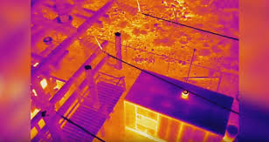
Sensors Thermal
Detects emitted energy (Near IR is reflected sunlight)
Use Case: Heat loss for energy audits
Use Case: Identifies heavily loaded circuits and equipment
(Credit: FLIR)

Slide 20
Orthomosaic Processing
Open Source – Open Drone Map
Pro - No cost to purchase. Runs in docker containers.
Con – Hardware requirements are steep.
Con – Time is the true cost. The learning curve is steep.

