Slide 1
Introduction to Power BI
Presented by Anastassiya Suprunova, GIS Analyst at ESRGC

Slide 2
Why Power BI?
Your organization might be choosing Power BI as a primary data analytic tool
You might be working in EXCEL and looking for more streamline tool to analyze your data
You might be working with multiple disjoint data sources
You are dependent on another person in your organization to analyze data
Price is one of the main drivers of Power BI success
Custom open-sources visuals completely integrated into the tool
Great for beginners, but not limiting for experts (example: R integration)
Robust support resources and documentation
Monthly updates

Slide 3
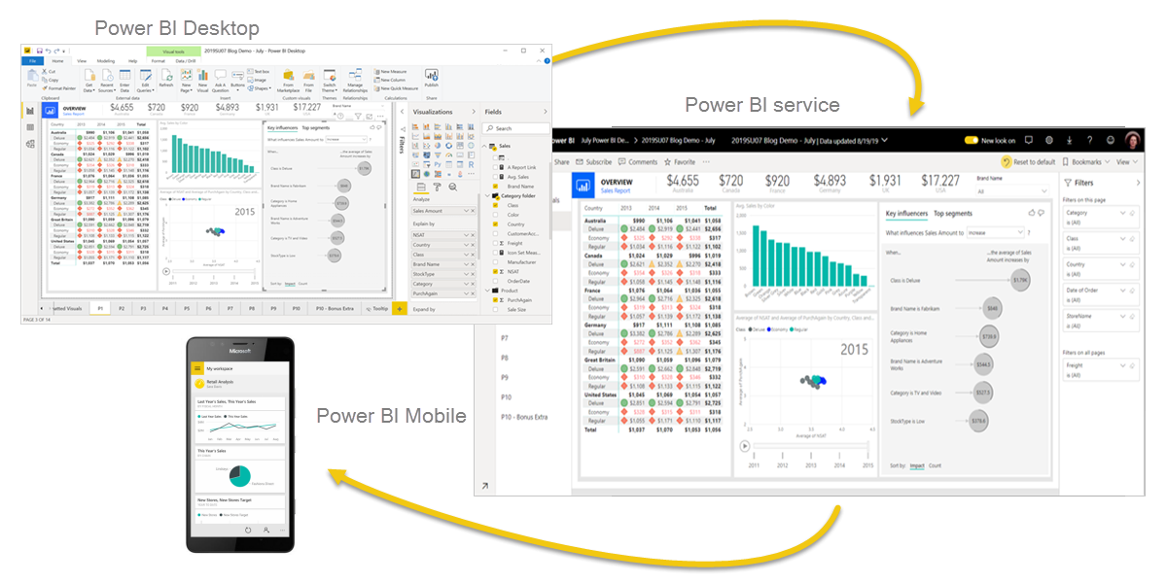
Power BI
Power BI is a collection of software services, apps, and connectors that work together to turn your unrelated sources of data into coherent, visually immersive, and interactive insights.

Slide 4
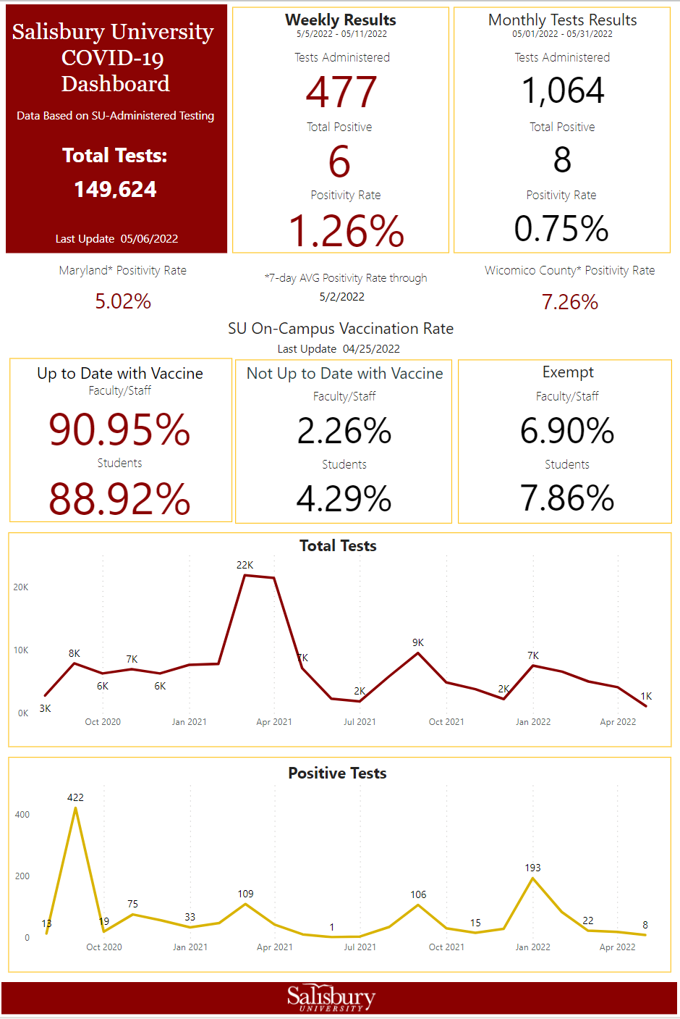
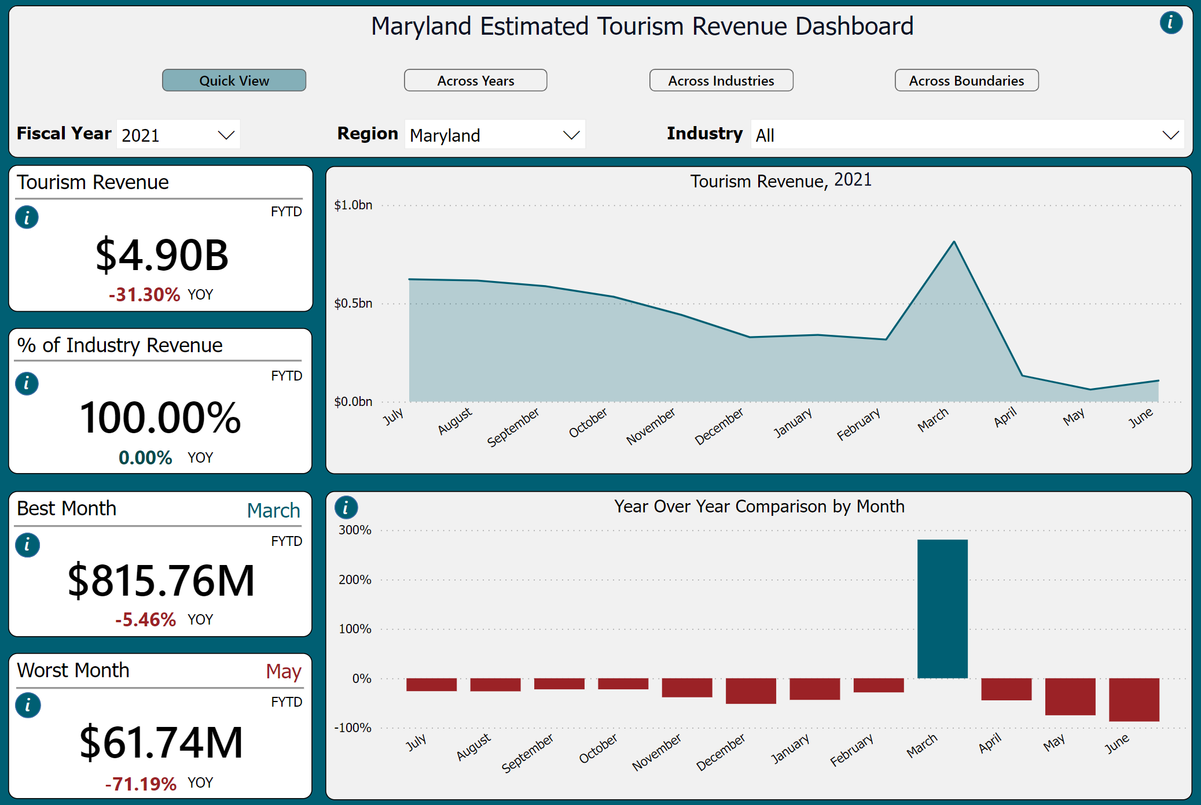
Examples
Will be available at: https://recovery.delmarvaindex.org/
https://www.salisbury.edu/coronavirus/testing-info.aspx

