Slide 1
GISCI’s GISP Certification – Part 1
An Overview of the Application, Portfolio, and Exam Processes
Presented by: Shannon Doyle, GISP, PMP, PhD
April 27, 2022

Slide 2
OVERVIEW
What is the GISP Certification?
GISP Application and Minimum Requirements
Portfolio Requirements
GISP Core Technical Exam
GISP Exam Knowledge Areas
Certification Renewal
Benefits of Certification
Intro to Part 2 – Exam Study Guide and Tips and Tricks
Questions/Discussion

Slide 3
What is the GISP Certification?
GISP – Geographic Information Systems Professional
Professional geospatial certification through the GISCI – Geographic Information Systems Certification Institute (www.gisci.org)
Portfolio (minimum 4 years of experience) and passing exam score required
Exam is based on core technical knowledge of geospatial professionals (not software specific)
More than 10k GISPs in US and world on the GISP registry
A GISP has met the minimum standards for educational achievement, professional experience, and contributions to the profession and has passed a core technical knowledge exam.
A GISP must abide by higher guidelines for ethical behavior.
3

Slide 4
GISP Application and Minimum Requirements
Register at any time on the GISCI website (www.gisci.org)
Application and Portfolio process are completed online
4 years of equivalent full-time geospatial experience
Meet the Portfolio Requirements (minimum point requirements in Education, Experience, and Contributions)
Show a knowledge of GIS across a broad area by passing the GISCI Geospatial Core Technical Knowledge Exam (Next exam window: June 4-11, 2022)
Complete all requirements within 6 years from date of Portfolio approval or passing the Exam

Slide 5
Portfolio Requirements
Step-by-step guide for completing the portfolio is located on the GISCI website
Minimum total points for the initial application is 150, with minimums of the three categories being:
Education 30 pts
Experience 60 pts
Contributions 8 pts
When the minimums in all three categories are achieved, the applicant must then specify 52 extra points in any of the 3 achievement categories
Documentation required for most Education and Contribution points. Supervisor letter required for Experience points
Required to sign Ethics Code of Conduct
Portfolio Review fee $100
Procedure Manual: https://www.gisci.org/Portals/0/Applicants/Applicant%20Services/GISCI_PROCEDURES_MANUAL.pdf
Review of Manual and examples of portfolio requirements

Slide 6
GISP Core Technical Exam
Exam Development Committee established in 2014
GISP implemented Core Technical Knowledge Exam implemented in 2015
Exam can be taken even before minimum experience and education requirements
Offered twice per year (June and December) at independent testing facilities located nationwide
Exam fee required $250, register online
Minimum pass score is reviewed each year by standard setting committee – current cut score is 73
Pass rates have reached and average of 60%
4-hour exam with 100 scored questions and 70-80 unscored (pretest items that could become permanent testing items)
Multiple choice and multiple response questions
Required to sign NDA
Practice Exam available on GISCI website

Slide 7
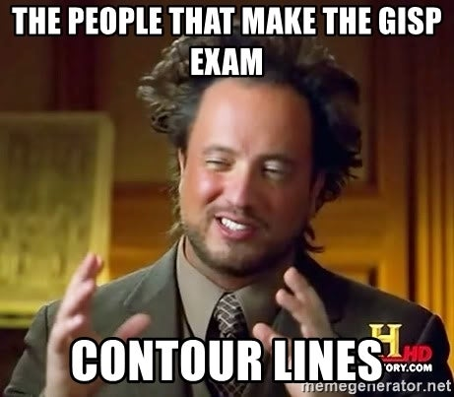
GISP Exam Knowledge areas
Conceptual Foundations (10%)
Geospatial Data Fundamentals (15%)
Cartography & Visualization (10%)
Data Acquisition (11%)
Data Manipulation (11%)
Analytical Methods (11%)
Database Design & Management (10%)
Application Development (7%)
Systems Design & Management (7%)
Professional Practice (8%)
Exam Candidate Manual: https://www.gisci.org/Portals/0/PDF's/February2021_ExamCandidateManual.pdf?ver=cjvlFz2lSrwC5HD23vV2aw%3d%3d
Full Exam Blueprint: https://www.gisci.org/Portals/0/PDF's/REVISED%20BP%20-%20Official%20-%20July%202019.pdf

Slide 8
Certification Renewal
GISP renewal/recertification is every three years, renewal fee applies
Must submit recertification online and provide point updates (education, experience and/or contributions)
Documentation generally not required
One-year grace period to submit recertification application
Updated paper certificate issued
Educational (courses/conferences) | 6 points minimum
Contributions to the Profession | 6 points minimum
Work Experience | No minimum requirement, up to 12 points optional
Additional points in any category | 12 points
TOTAL | 24 points

Slide 9
Benefits of GISP Certification
One of just a few geospatial professional certifications (ASPRS, Esri, NGA)
Contract requirements, preferences
Professional and personal development
Resume credentials
Certification exam experience
Certification committee opportunities
Network of fellow GISPs
What else? Discuss…
Image credit: https://www.directionsmag.com/article/8411

Slide 10
Intro to Part 2 – Exam Study Guide & Tips and Tricks
Part 2 May 4, 2022 for detailed exam tips and tricks
Use the exam blueprint as your guiding document for Google searches and textbook studying
Look at the unofficial study guide and materials on the GISCI website
Reddit has a lot of information and tips as well
Utilize the online practice exam
Keep in mind that the exam is geared to people with a minimum of 4 years of experience as well as geospatial-related education
Exam is core technical knowledge but NOT software specific
Biggest tip – you WILL need to study! Most people who pass put in at least 20-30 hours or more of study time.

Slide 11
Questions/Discussion
Thank you for attending!
Email: SDoyle@jmttg.com

